Slide 1



Food In Focus

Slide 2

Food In The Body Gives A Chance For Thoughts In The Mind

Slide 3
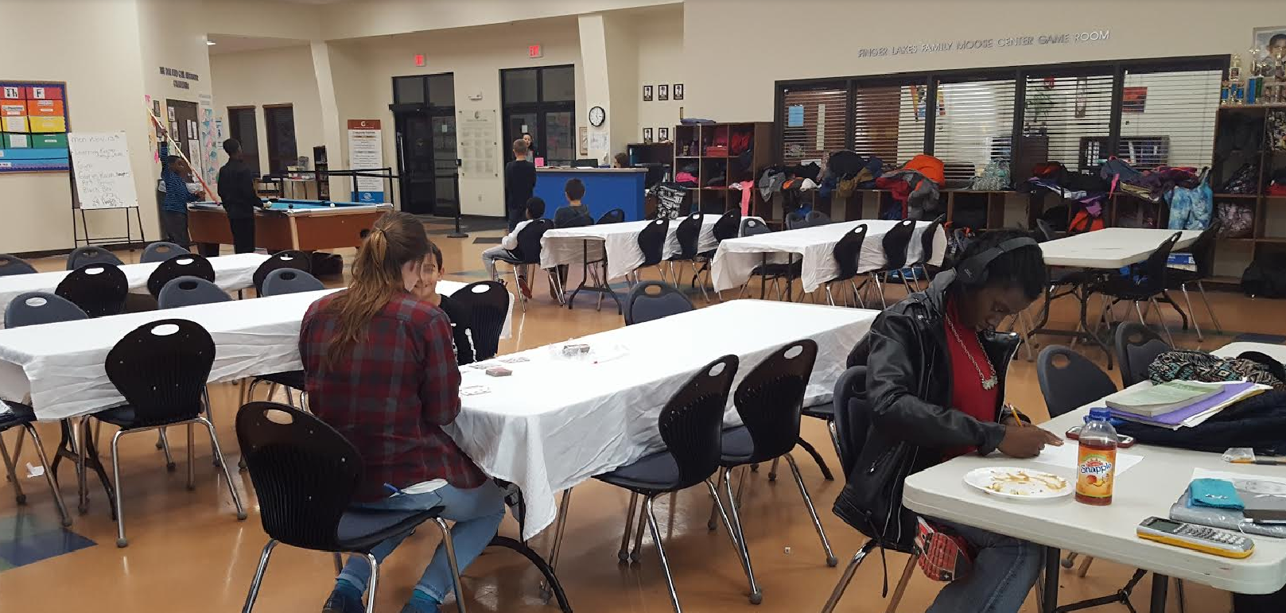
70 Dinners, 5 Nights A Week

Slide 4
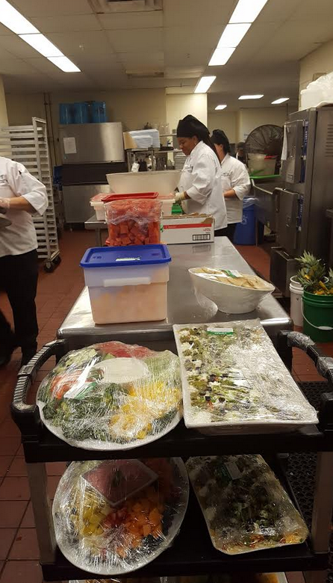


New York State Health Department Requirements
Meat
Vegetable
Whole Grains
Low-fat Milk
Salad

Slide 5
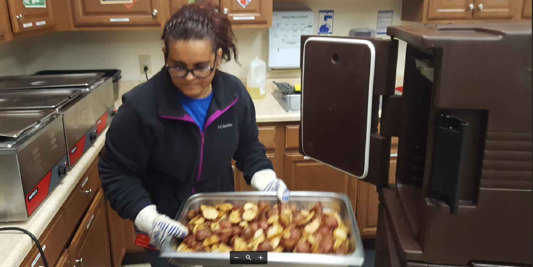
5 p.m. Delivery In Hot Boxes

Slide 6
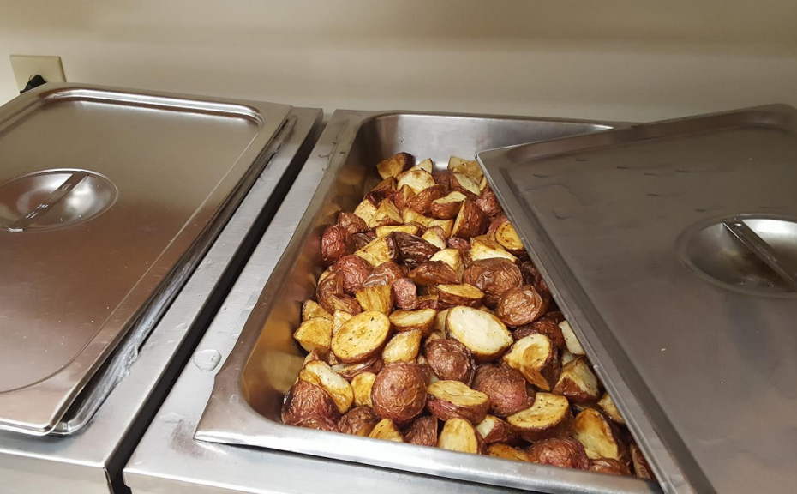
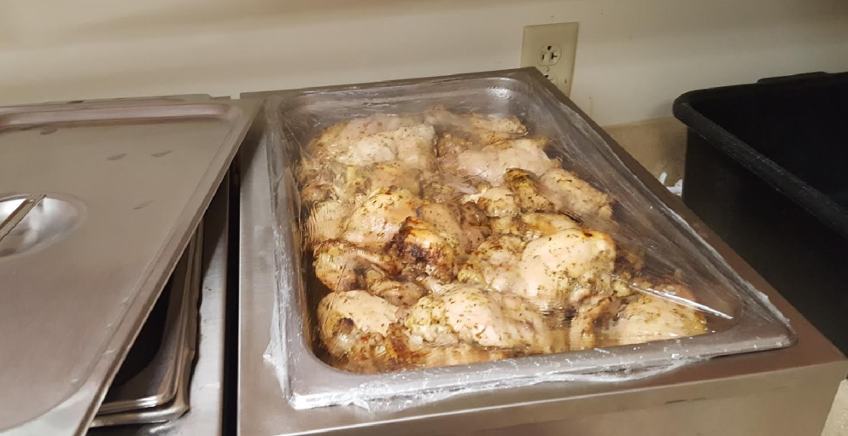
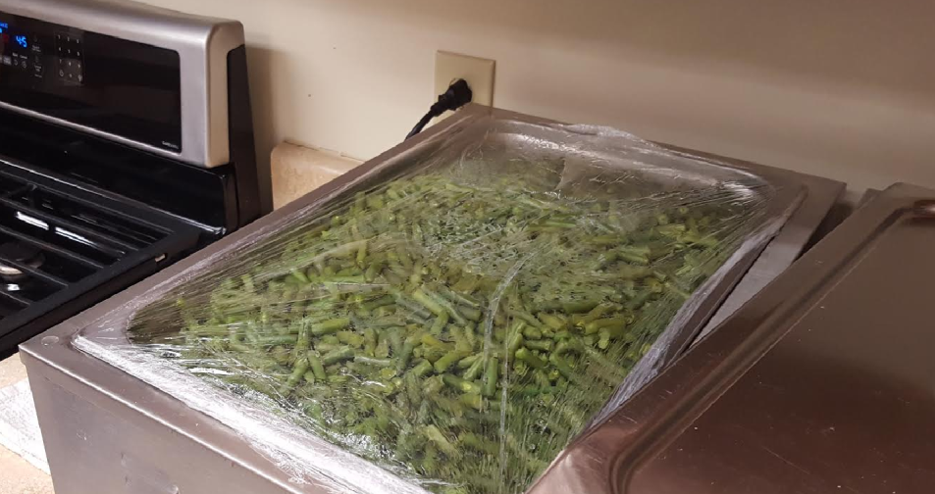
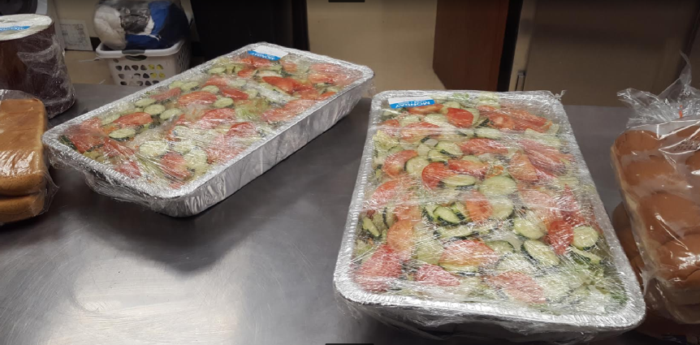

Slide 7
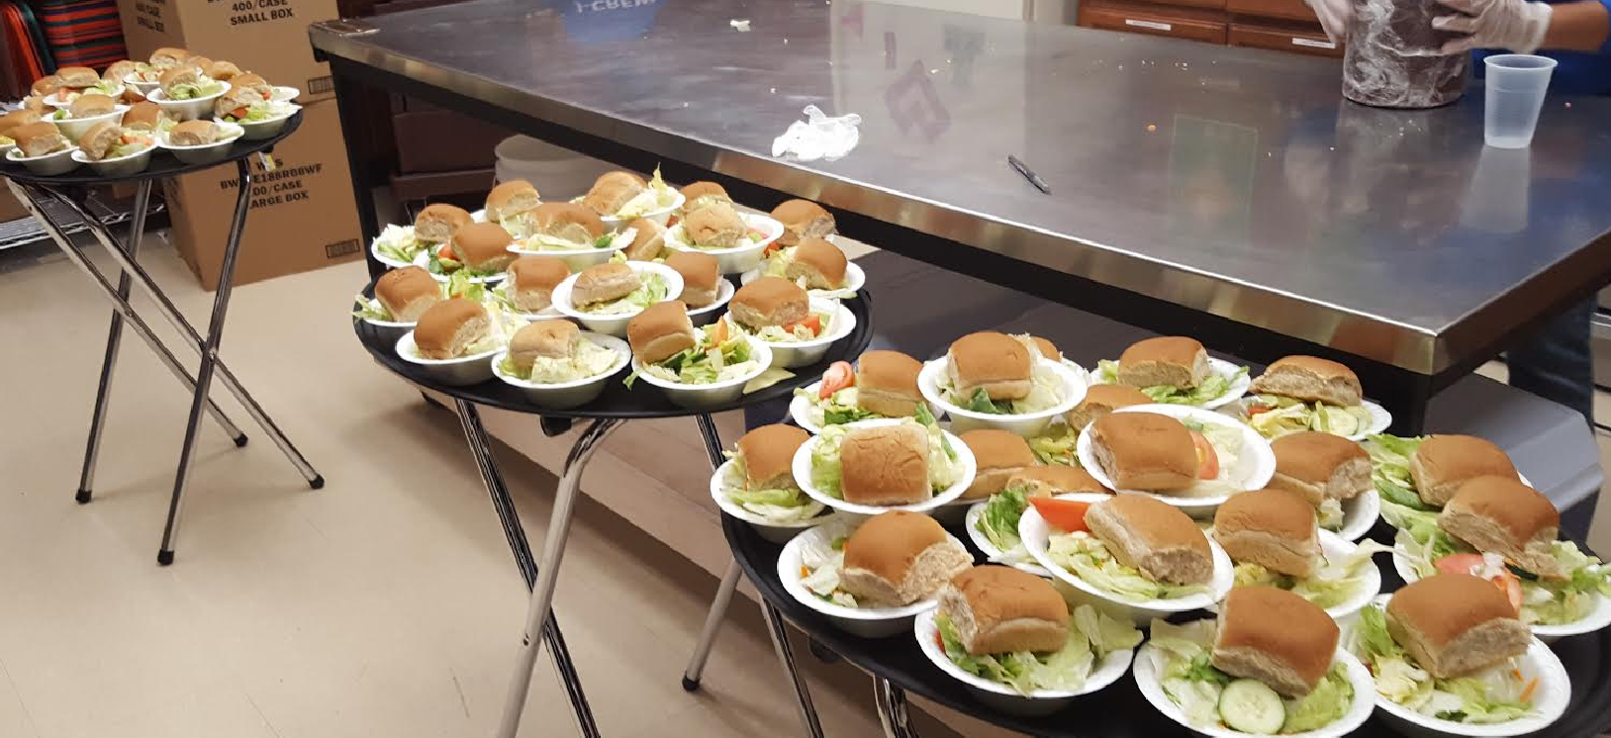
Dinner Starts With A Salad And Wheat Roll Course

Slide 8
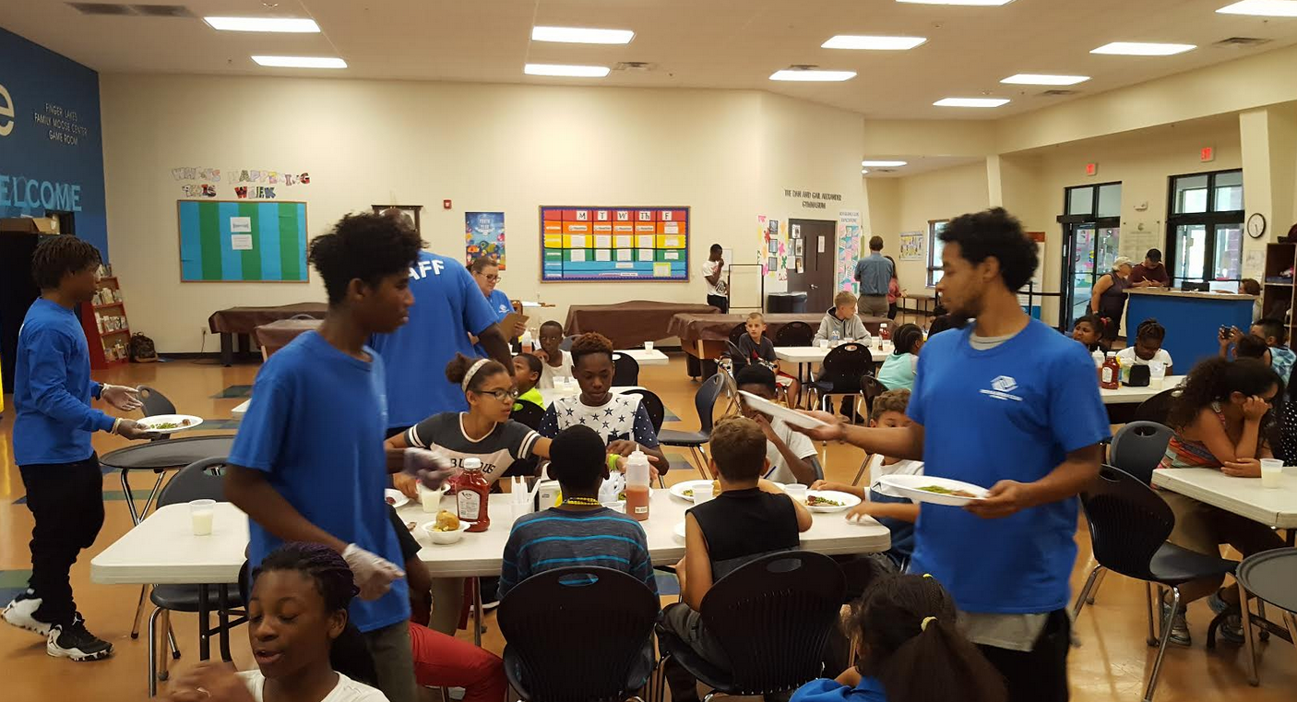
Staff And J-Crew Serve

Slide 9
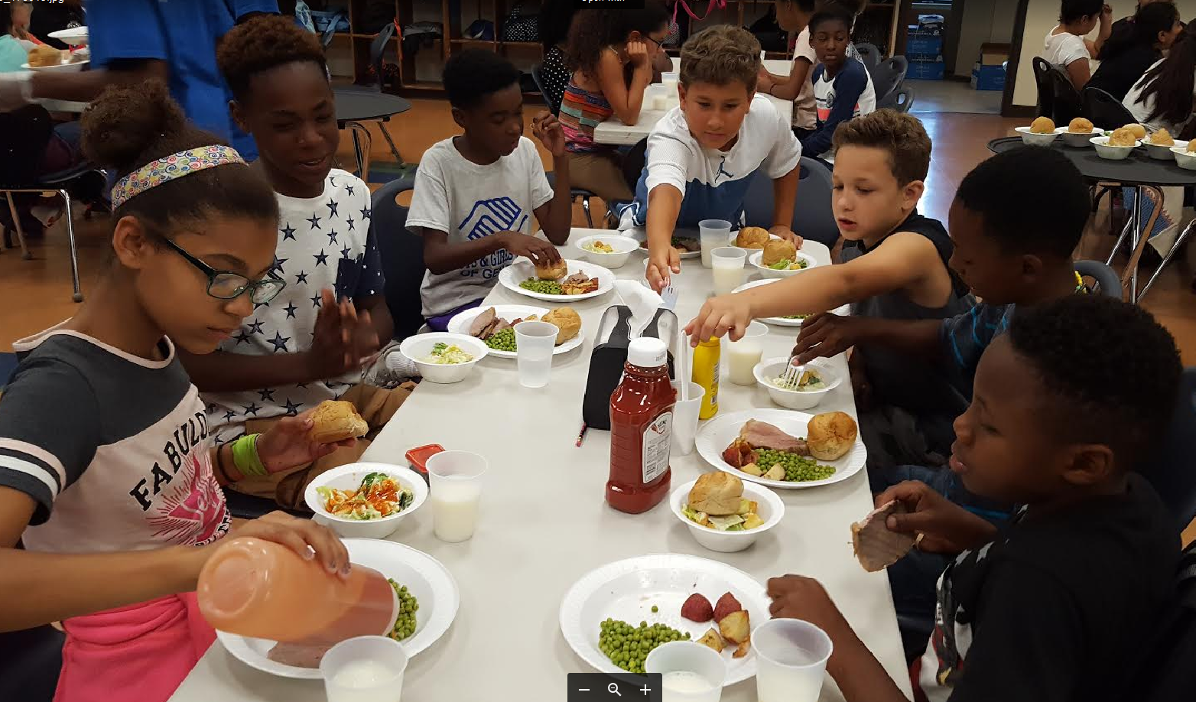
Ketchup Is A Vegetable!

Slide 10
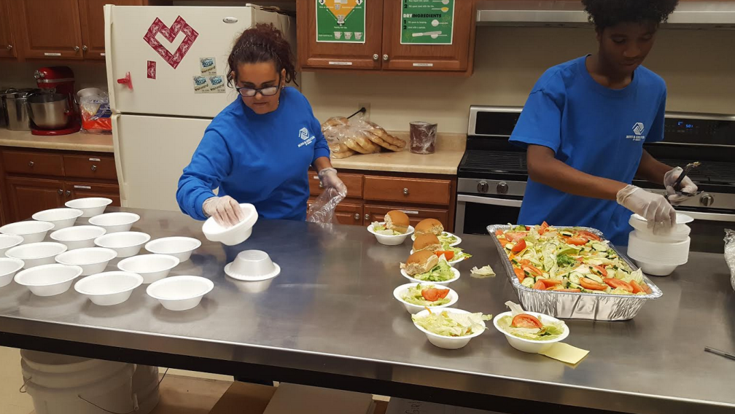
By The Numbers
School Year
16,800 Dinners Per Year
14,400 Lunches
21,600 Snacks At Carter
13,200 Goodman Snacks
104 Cases of Apples
720 Gallons of Milk
Summer Feeding
4,200 Lunches
5,000 Snacks
Costs:
$55,000 For Dinners
$15,000 For Lunches

