Slide 1

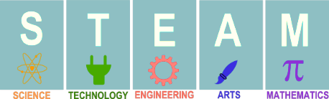
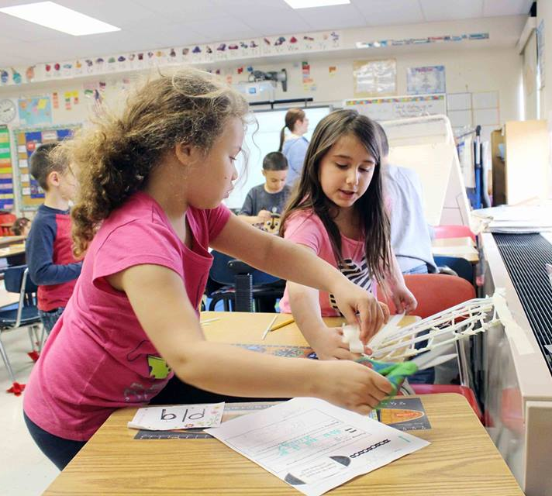
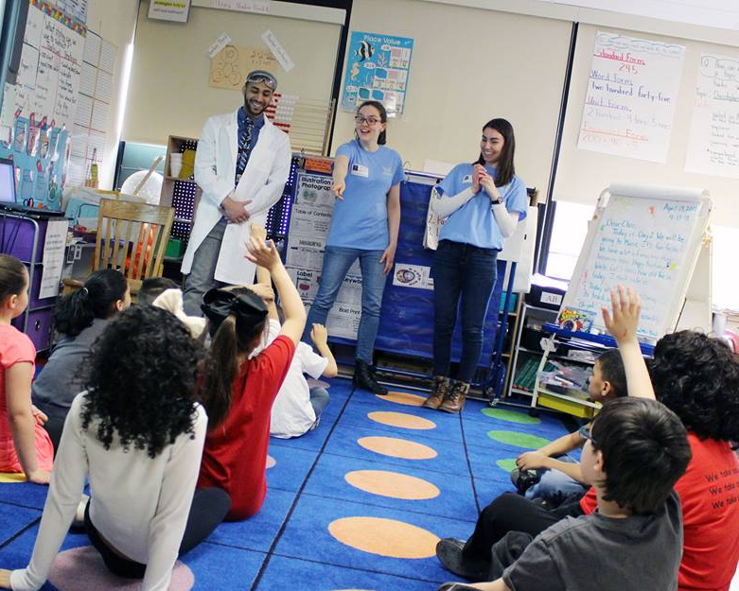

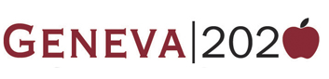
Full STEAM Ahead: Evaluating the STEAM Community in Wayne & Ontario Counties
Molly Bruce, Sasha Carey, Ellie Cook, Davis Moffly & Lauren Proctor
Hobart & William Smith Colleges
CLIENTS
RESPONDENTS
PRELIMINARY RECOMMENDATIONS
Geneva 2020
“Cradle to Career”
Collective Impact Initiative
Goals: improve student success through writing and literacy
Graduation Rates: Since 2011, they’ve improved graduation rates from 70.7% to 84.9%
FLCC
Main campus in Canandaigua; Campus centers in Geneva, Newark, and Victor featuring a Viticulture center
Provide many associates degrees and specialty certifications: many STEAM related
We reached out to 36 STEAM employers in Ontario and Wayne counties, including viticulture, graphic design, architecture, automotive and health care companies. While we only got 15 survey responses, these 15 employers represent almost 5,000 jobs. The respondents indicated that they are willing to provide training for entry-level employees and have a flexible preferred education levels for entry positions. These companies include:
Ontario ARC
Van Bortel Group
Finger Lakes Viticulture and Wine Center
O’Connell Electric
In. Site: Architecture
SpaceVinyl
Pettinger Sheet & Metal Fabrication
GENEVA 2020
Encourage STEAM career opportunities throughout high school to maintain interest and limit the students who lose interest over the years.
Encourage literacy and writing skills, and link it with science courses.
Stress experiential learning and internship opportunities
Highlight the Gemini Program
FLCC
Employers want candidates with literacy and interpersonal skills even within tech jobs. If FLCC and Geneva highlight this, their students will stand out.
Continue to push students towards higher education - jobs in this area need high level workers.
Continue to provide students with internships opportunities
MATERIALS AND METHODS
Research Questions: What do STEAM employers look for in current and future employees? How do these skills match up with the skills they’re learning in high school and at FLCC?
Parameters: Ontario County, Wayne County
Geneva, Canandaigua, Victor, Clifton, and Farmington.
“Most graduates either are great designers with a lack technical understanding of how buildings go together, or technically advanced but without the ability to conceptualize and represent a compelling design vision.”
WHAT IS STEAM?
Survey*:
What is the current number of employees at your company?
Where is your company headquarters located?
Do you have a recruitment protocol?
What are the primary positions that you hire?
Where do you seek out hirable candidates for employment?
What are the positions within your company that are hardest to hire for? why?
Are there opportunities within your company for employers to move up?
Do you have a preferred education level for entry level positions? What is it?
If no education level is preferred, do you provide education for these entry level positions?
If you answered yes, where does your employee education take place?
Would you consider outsourcing your employee education?
What are the STEAM (science, technology, education, art and math) skills necessary for a position at your company?
Are there necessary STEAM job skills that you do not often find in applicants?
Do you have any connection with Finger Lakes Community College (FLCC) or any other colleges in the area?
When candidates from these local colleges apply to your company, are they coming with the necessary skills and qualifications?
How do you see your company evolving over the next 10 years?
Do you see a need for new employees?
If yes, do you see a need for new educational training for these positions?
*The bolded survey questions are the questions that we pulled our most valuable data from
STEAM is an extension of STEM: Science, Technology, Engineering, Art & Math
According to the New York State Department of Labor, STEM jobs offer competitive wages almost 60% higher than non-STEM careers
STEM careers target the 18-24 age range, with men dominating the field
From 2010 to 2015 in New York State, STEM job titles grew by 10.5% (or by 45,444) to 478,338 jobs.
In the Finger Lakes region specifically, increased by 7% (from 32,803 jobs to 35,238 jobs)
EXISTITNG LITERATURE
Egley (2015)
Creativity is one of the top three personality traits important to career success
STEAM employers are looking for that trait in their employees, hence why the ‘A’ was added
85% of employers can’t find “creative” applicants
Tkaczyk (2013)
Disconnect between classroom to career
High school students losing interest in STEM from their first to last year of high school
60% of students graduating college with STEM degrees aren’t going into STEM careers
Students need relevant classroom experiences and/or afterschool programs that do not just teach STEM classes, but provide real-world application
The survey was administered to 36 STEAM employers. We sent an initial email to the company, and followed up if the companies had not answered the survey within five days of sending the email. After sending multiple follow-up emails, we called the companies, which lead us to receiving a 42% response rate.
BIBLIOGRAPHY
Bailey, C. (2015, March 31). An artist's argument for STEAM education. Retrieved from http://www.modeldmedia.com/features/artsinSTEM033115.aspx
Egley, E. (2015, October 28). What is STEAM? Retrieved from http://edu.stemjobs.com/what-is-steam/
Geneva, NY. (n.d.). Retrieved from https://datausa.io/profile/geo/geneva-ny/
HWS: Geneva 2020. (n.d.). Retrieved March 15, 2018, from http://www.hws.edu/about/geneva2020_priorities.aspx
Jacobs, P. (2014, July 09). Science And Math Majors Earn The Most Money After Graduation. Retrieved from http://www.businessinsider.com/stem-majors-earn-a-lot-more-money-after-graduation-2014-7
SUNY. (n.d.). Finger Lakes Community College. Retrieved from https://www.suny.edu/campuses/finger-lakes/
Tkaczyk, J. M. (2013). HIRE EDUCATION: STEM and the TRANSPORTATION INDUSTRY. Career Planning and Adult Development Journal,156-161.

