Slide 1


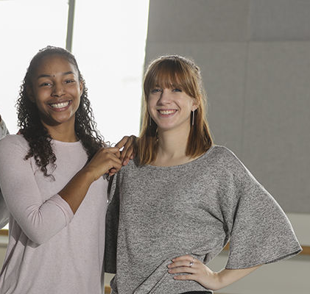


Power of Dance Program
St. Peters Community Arts Academy
Donna Davenport
Jackeline Matos
Shaahida Samuel
Kayla Malcolm
Ellie Cherry

Slide 2
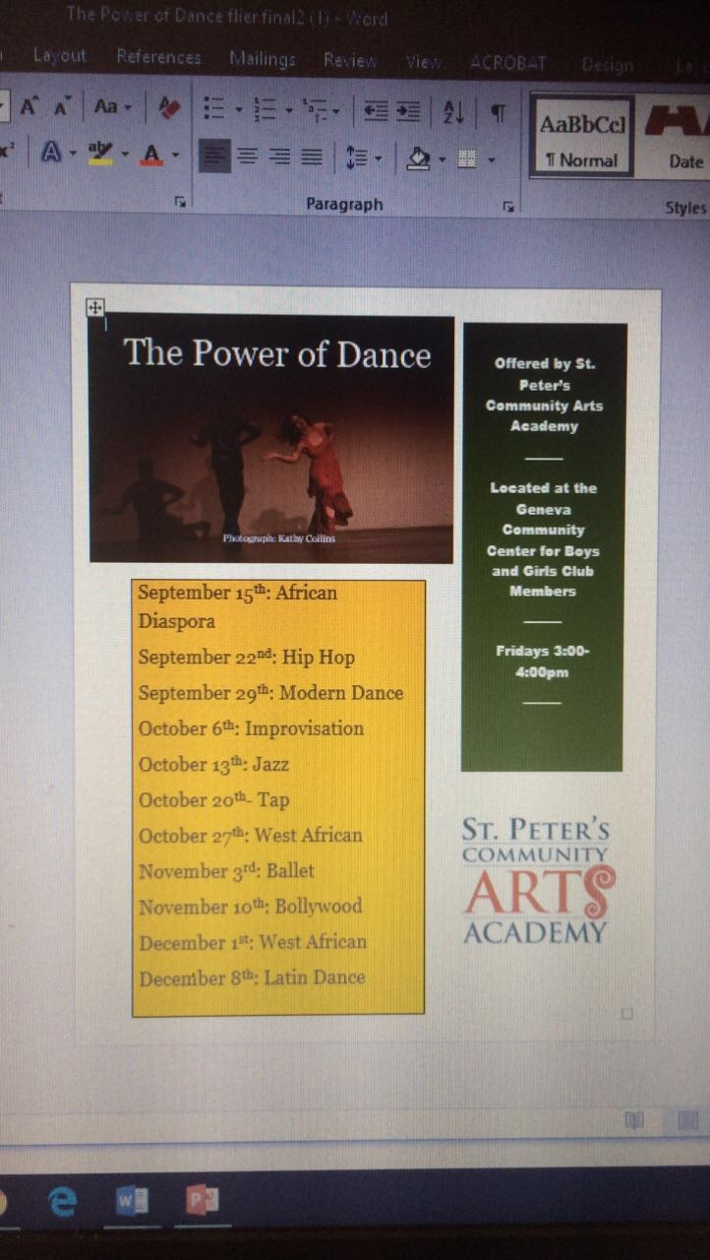
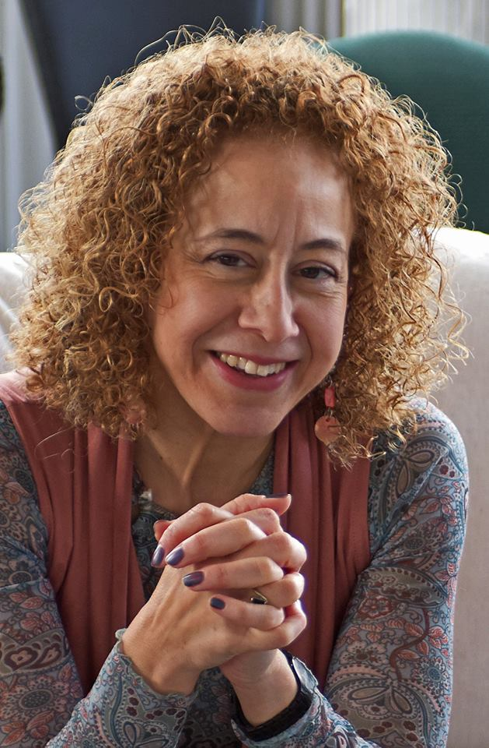

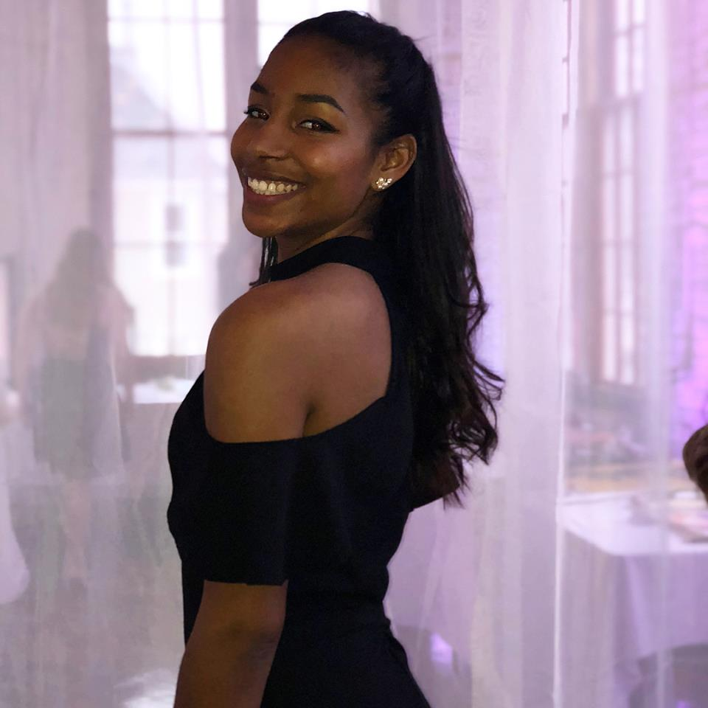




Fall Semester: Power of Dance
Led by: Kayla Malcolm
Teachers: Jackeline Matos, Shaahida Samuel
Shaahida
Samuel
During the fall semester, I, Jackeline, was the head teacher at the Boys & Girls Club of Geneva. Alongside me was Shaahida Samuel; we would alternate teaching days. We taught a variety of different dance forms to the kids at Boys & Girls Club. We taught West African, Bollywood, tap, ballet, hip hop, jazz, and merengue.
Donna Davenport
Kayla Malcolm
Jackeline Matos

Slide 3
Fall Semester Schedule

Slide 4

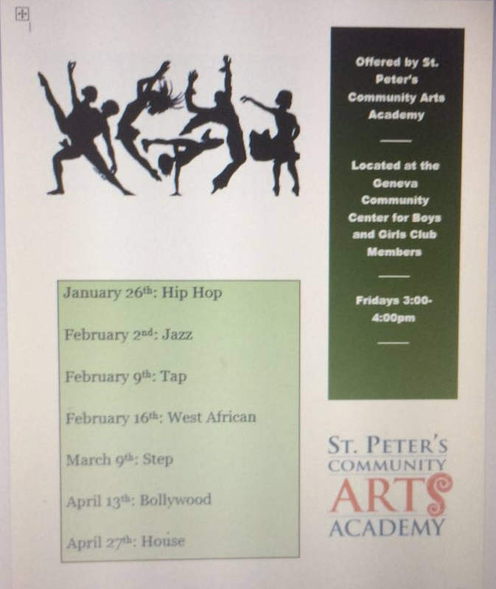

Spring Semester: Power of Dance
Led by: Ellie Cherry
Teachers: Jackeline Matos, Ellie Cherry
During the spring semester, I, Jackeline, was the head teacher again at the Boys & Girls Club. Alongside me was, Ellie Cherry; we would alternate teaching days, similar to last semester. We taught a variety of different dance forms to the kids at Boys & Girls Club. We taught West African, Bollywood, tap, step, hip hop, and Latin hip hop.
Ellie Cherry
Jackeline Matos

Slide 5
Spring Semester
Schedule

Slide 6
This would not have happened if not for the help and support from St. Peter’s Community Arts Academy. Thank You!
-Jackeline Matos, Kayla Malcolm, Shaahida Samuel and Ellie Cherry

