Slide 1
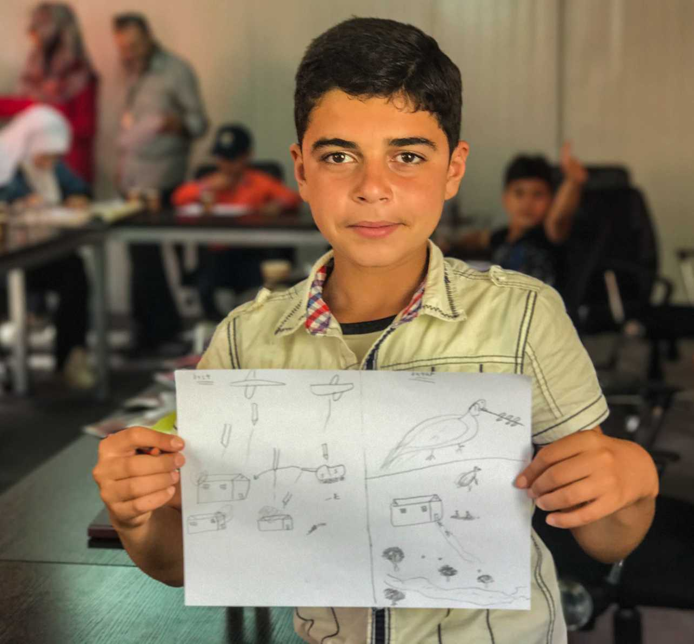
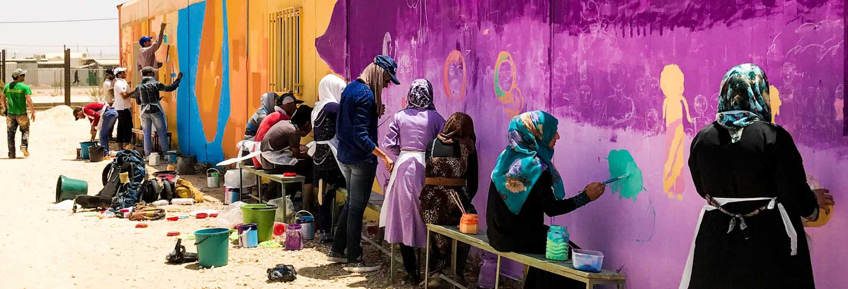
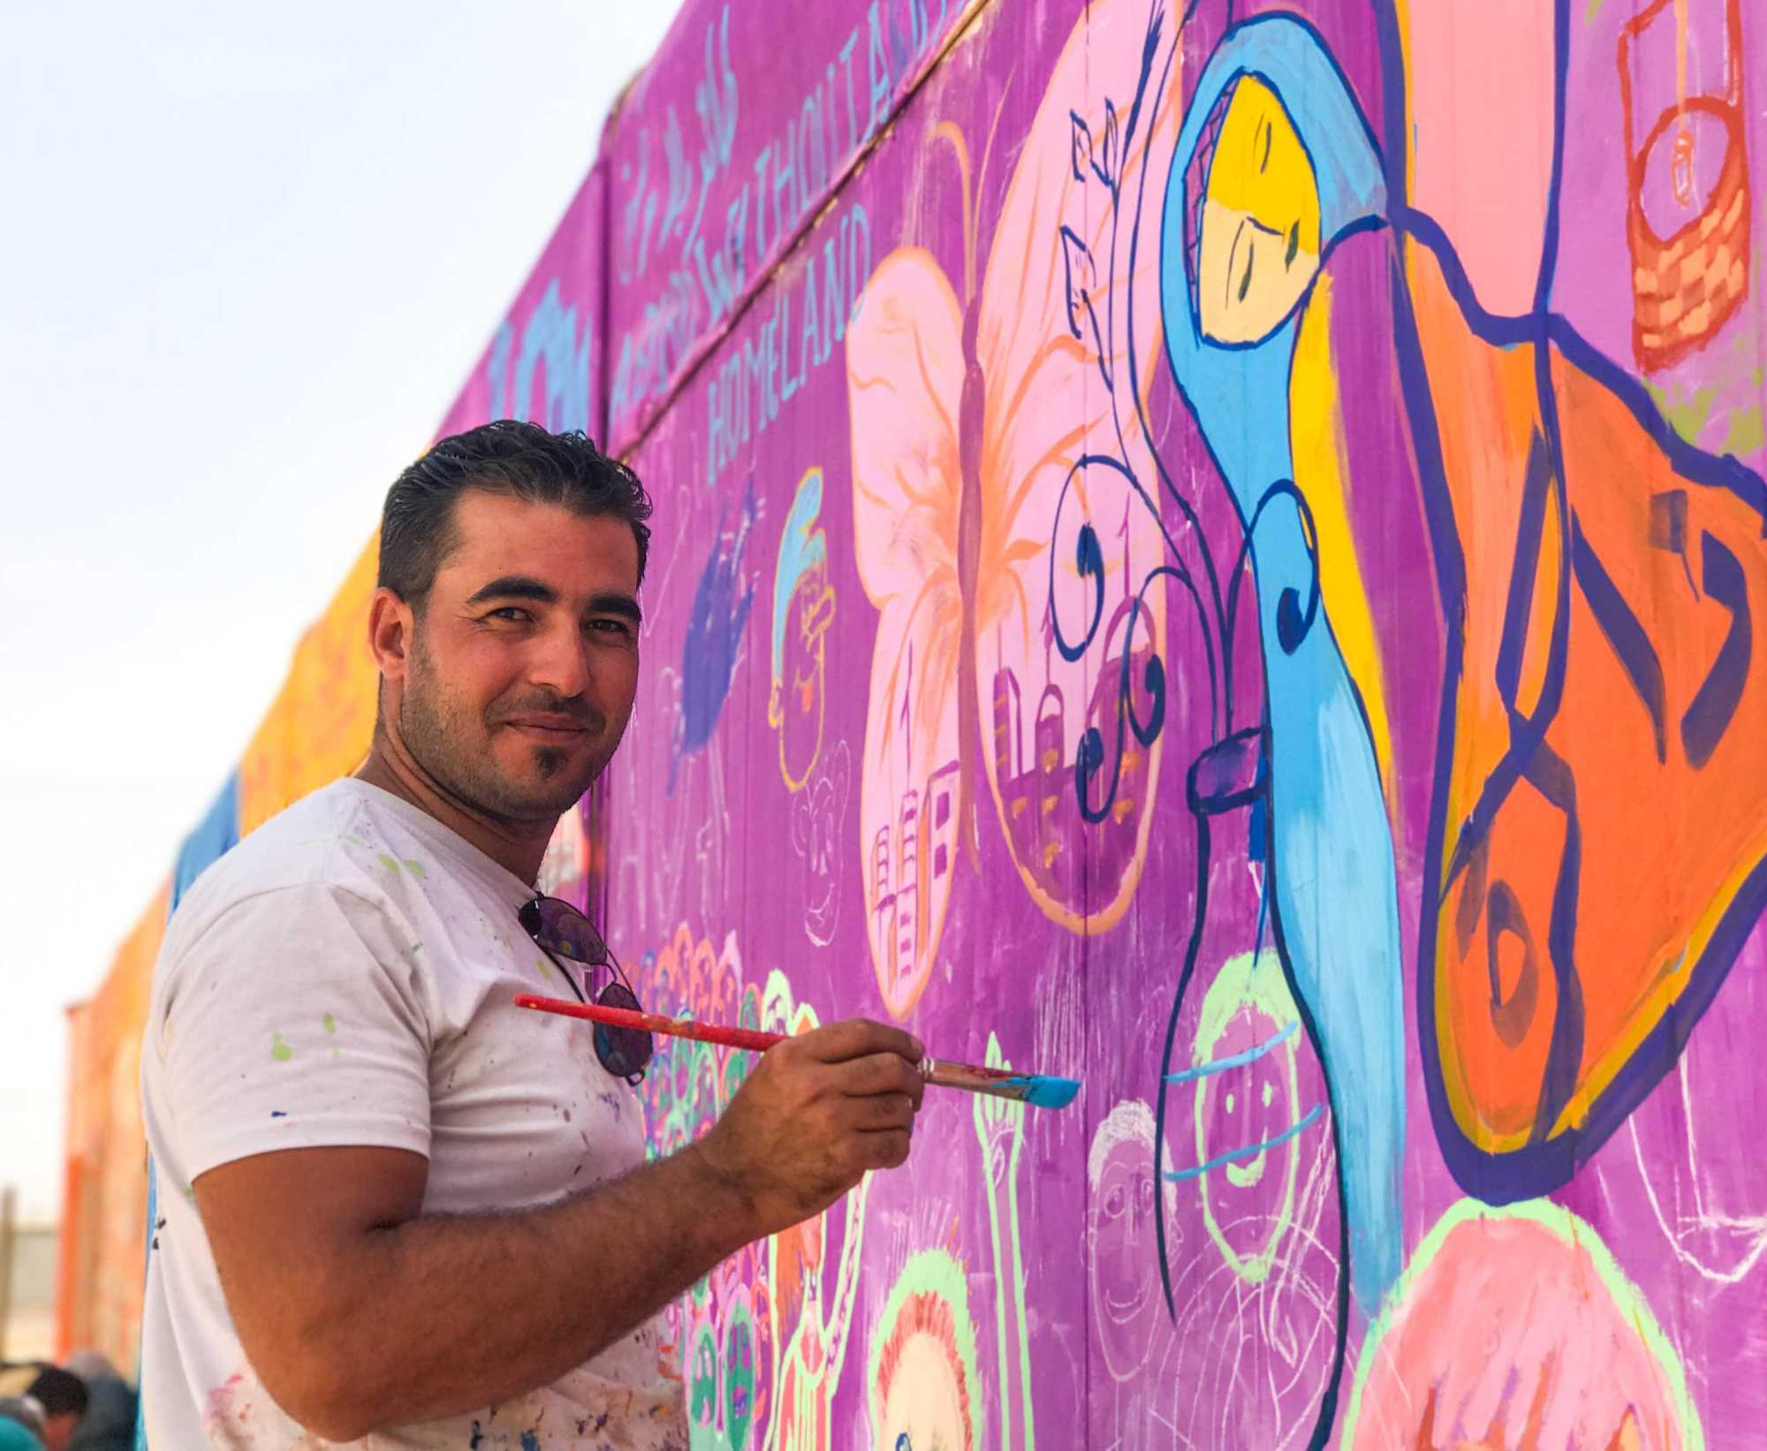
Assessing and Addressing Trauma through the Arts: A Program for Refugee Children Ryan Montbleau PCST 450- Peace Studies Capstone- Steven Lee
Introduction:
Learning goals
The goal of this independent project was to create a program that effectively “enacted peace” in the community. Over the course of this semester, I was allowed to craft a program of my choice that related to current issues of human injustice and human atrocity. In light of this, I chose to focus on the current refugee situation in the US and around the world. More specifically, my goal was to learn more about child refugee education and its disruption due to relocation, stereotyping , and marginalization.
Reflection:
Over the course of this semester, my work was separated into two main categories: research and event preparation. Initially, I had to gather research surrounding issues dealing with child refugee education, data on refugee trauma, as well as information which supported art initiatives as viable options for personal and community healing. By writing a paper that called on the need for art initiatives, while simultaneously demonstrating their success around the world, I was able to exemplify the need for such a program and its potential in impacting refugee communities in the Finger Lakes Region.
My experience over the course of this semester was humbling and eye-opening. As an individual who is committed to a career in human rights, I found the current global refugee situation to be complex and ever changing. In the same way, I was reassured that even if international policy and action surrounding the refugee crisis is stagnant, there are a multitude of grass roots approaches that have been effective around the world, giving support to the implementation of more multifaceted solutions in the future.
Potential Community Partner
Name: Refugees Helping Refugees
Mission Statement
“RHR seeks to foster the growth, self-determination, and self-reliance of Rochester’s refugee community by making them agents of their own advancement. It seeks to become a comprehensive community center providing a full range of services to its own community while also welcoming people from all cultures, ethnicities, and backgrounds.”
- Refugees Helping Refugees
Project Purpose /Need:
The purpose of this project was to provide a program that utilized the arts/performing arts to encourage self-expression, identity building, and personal healing amongst child refugees. Around the world, there are many examples where art installations have been implemented in temporary refugee settlements as well as areas of refugee relocation. These installations are used to facilitate community building, community healing, and community engagement, which are the central aspects this project drew inspiration from. In this same way, this project sought to provide similar opportunities specifically to refugee children whose access to education has been disrupted and who are suffering from emotional trauma.
Course Concepts
As stated in its curriculum, Peace Studies at HWS aims at encouraging students to commit themselves to the non-violent resolution of conflict in relations among individuals, groups, and societies. The entirety of this project, which used art as a mode of self-expression, resilience, and change, was based on this principle of non-violence amidst situations of immense conflict. This project aimed at showing that true change is shaped by a diversity of approaches which draw from all fields of study. In order to find proper solutions, people must be willing to look at these situations from angles different than the norm. Using art to assess and address trauma within refugee communities is an example of this diversity in approach.
References
Images: The Syrian Refugee Art Initiative. (2018, March 14). Retrieved from https://joelartista.com/syrian-refugees-the-zaatari-project-jordan/
Quick Facts
Children account for more than 50% of refugees worldwide
Since 2018, refugee children have lost out on over 700 million days of school
Refugee children are five times more likely to be out of school than regular children
Art provides a platform for these children to tell their own stories
Art serves as a vehicle for for self development and personal expression
Sources
United Nations. (2019). Figures at a Glance. Retrieved from
https://www.unhcr.org/figures-at-a-glance.html
Save the Children. (2019). Retrieved from https://www.lostlearning.org/
Children Uprooted. (2019). Retrieved from https://www.unicef.org/children-uprooted’
4 & 5. Parater, L. (2017, June 29). 7 Art Initiatives That Are Transforming the Lives of Refugees. Retrieved from https://www.unhcr.org/innovation/7-art-initiatives-that-are-transforming-the-lives-of-refugees/

