Slide 1


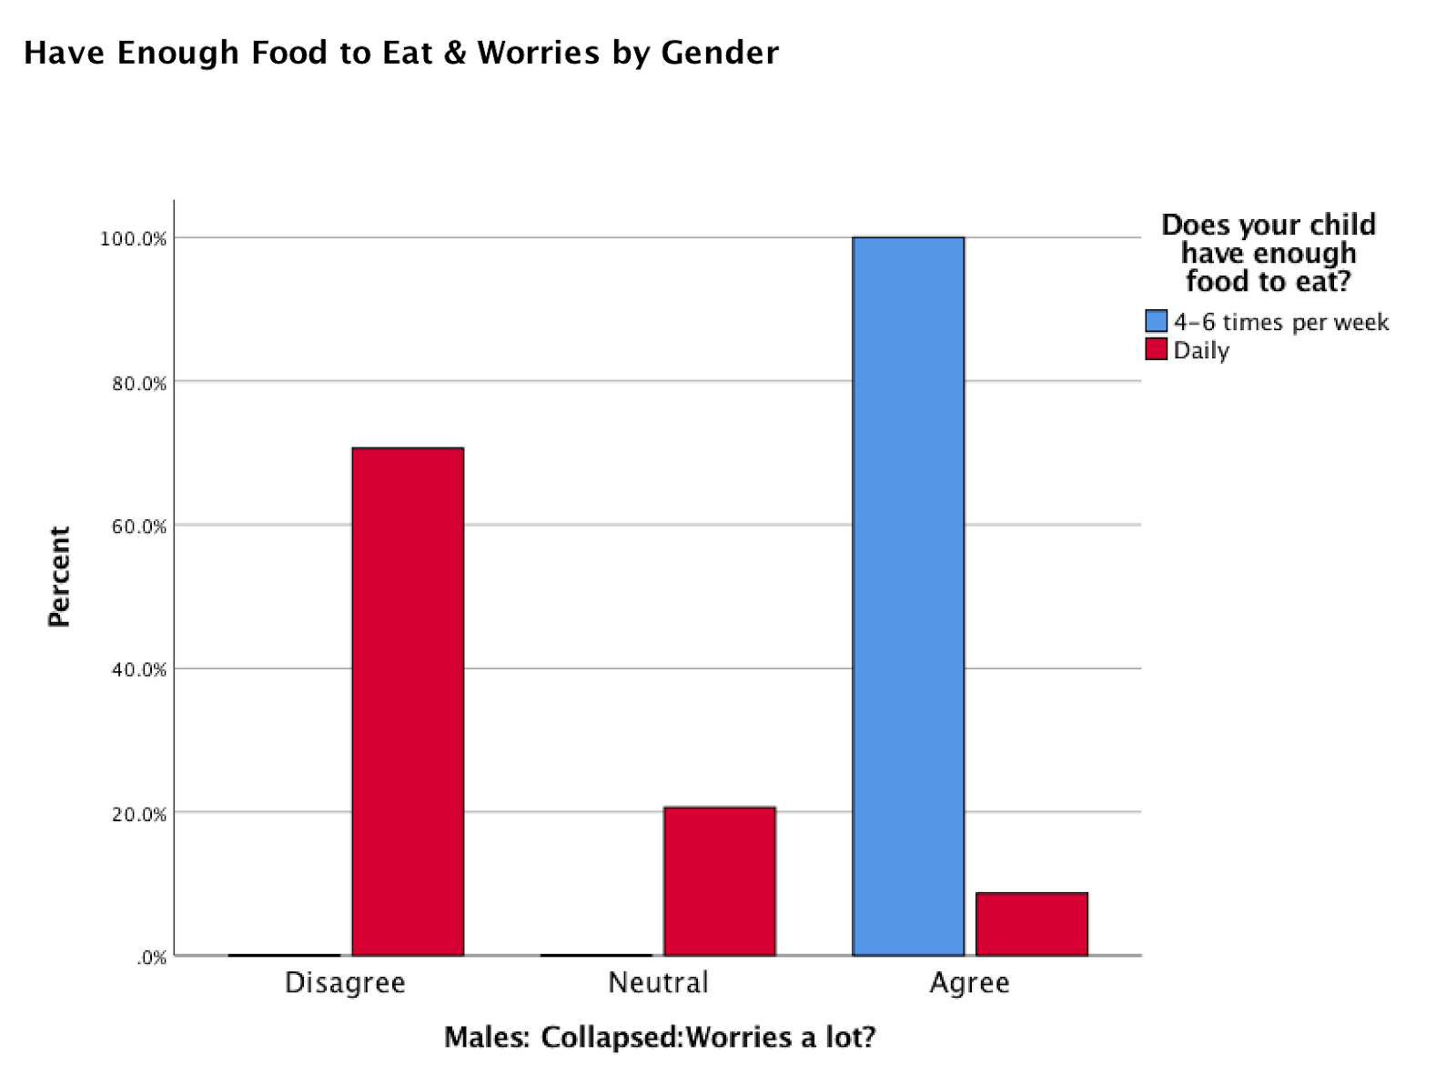
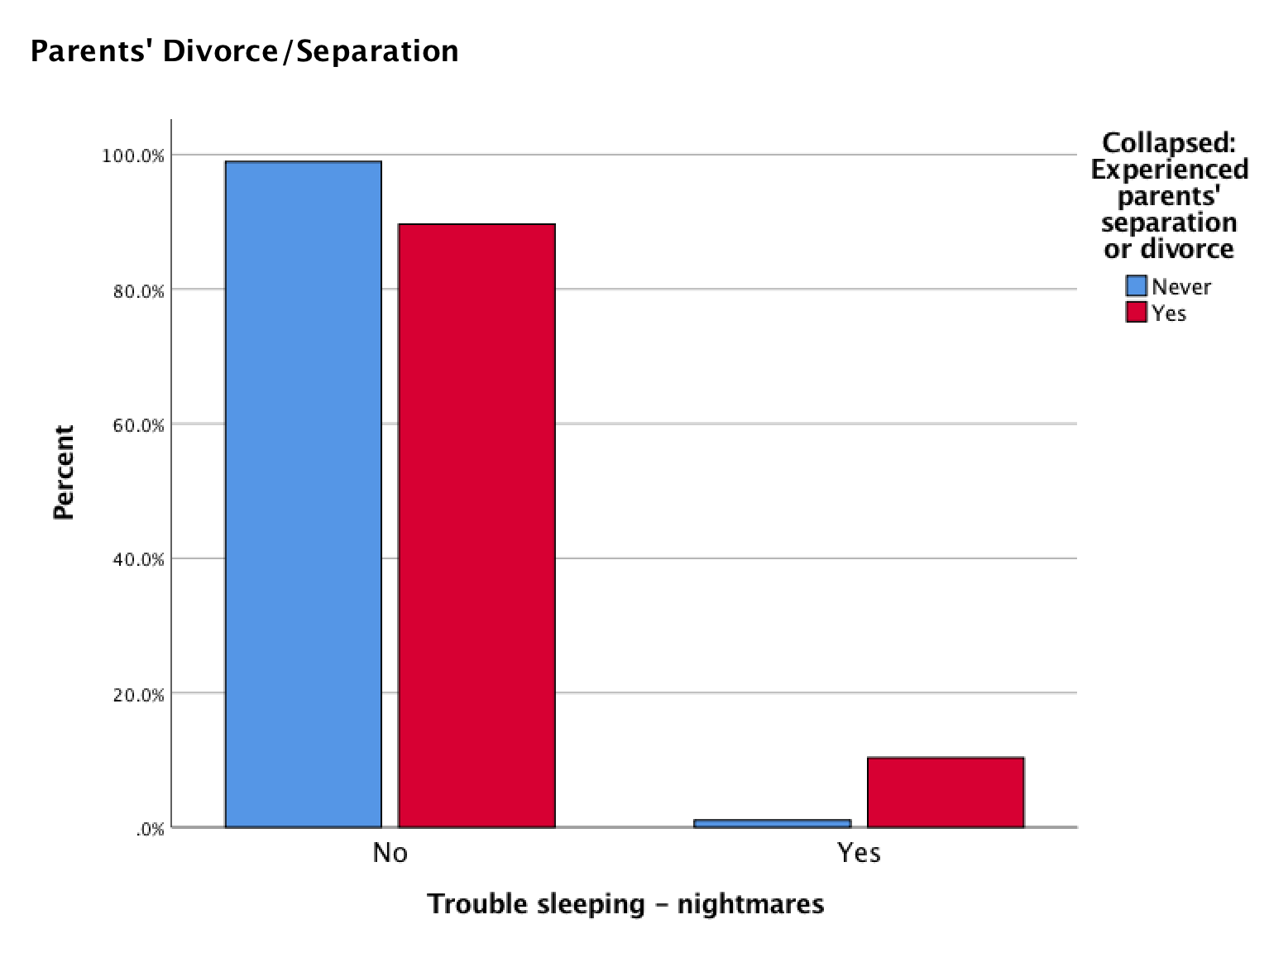
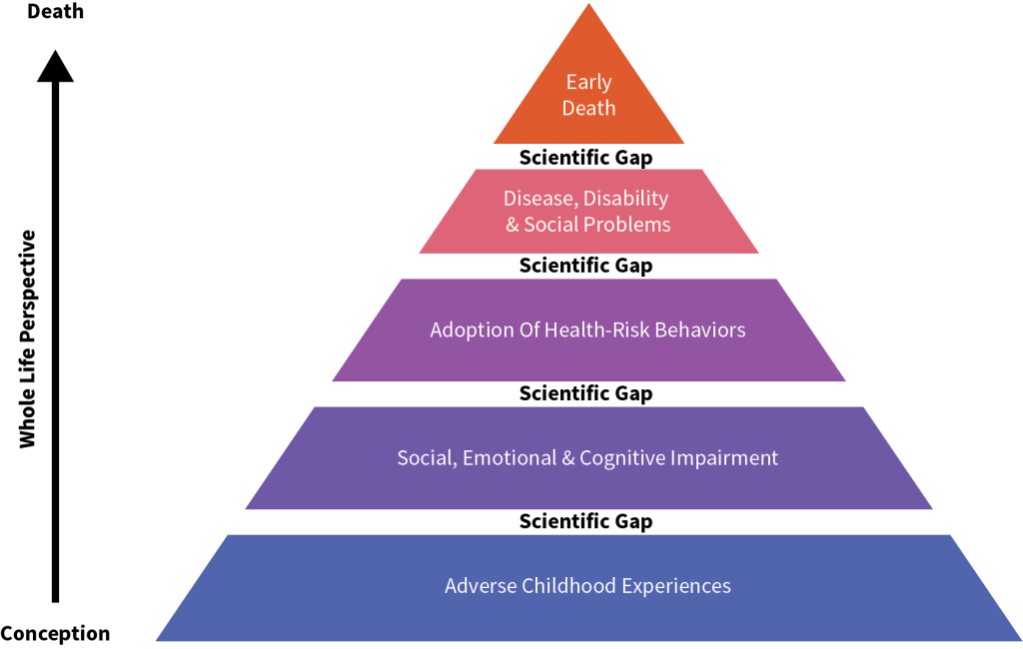
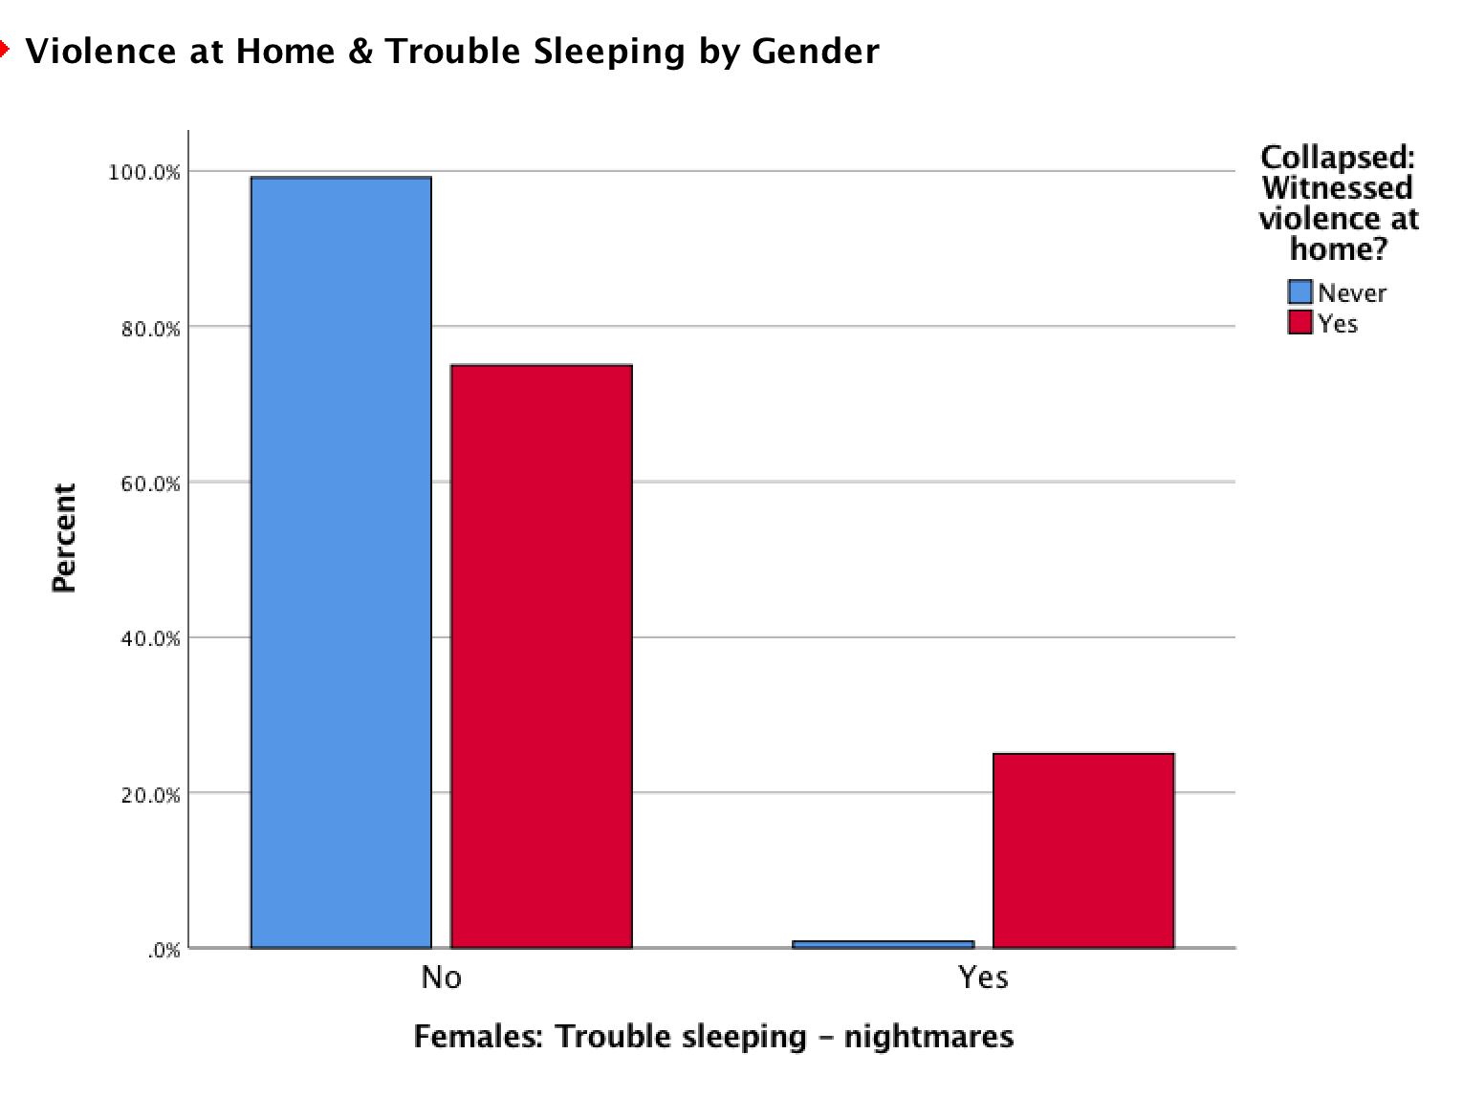
Detrimental to Childhood: An Analysis of Correlations Between
Kindergarten Children and GPACE Scores
Sally Dent
Hobart and William Smith Colleges, Geneva, NY
Introduction
  The PACE, Parent Appraisal of Children’s Experiences, Survey is a survey created by the Children’s Institute in Rochester, NY in 2015. This survey is completed by parents of young children, and includes a variety of questions pertaining to home functionality, parents’ personal experiences as well as children’s development. The focus of this research study is on the particular part of the survey pertaining to social, emotional, and behavioral functioning of the child in relation to life experiences of the child. The questions which fall under the section of Life Experiences parallel questions which are asked on the ACE Survey.
  The ACE, Adverse Childhood Experience, Survey has been a useful, self-report tool in assessing aspects of abuse and neglect amongst children for years. The perception is that higher ACE scores may be a predictor of future disadvantageous outcomes for individuals. Patterns of ACEs and unfavorable outcomes have been explored in many dimensions. Downey et al. (2017) found that childhood abuse and household dysfunction are associated with a variety of behavioral risk factors and chronic illnesses in adulthood. These ACE experiences have proved a significant relationship with future impairments, ailments, and overall problematic outcomes. Research conducted by Baglivio and Epps (2016) found that females are more likely than males to experience certain ACEs, which raises the component of gender as a potential mediator variable.
  Geneva has adopted its own version of the survey, the GPACE Survey, Geneva Parent Appraisal of Children’s Experiences Survey. This survey has been administered to parents of Geneva children entering kindergarten for a number of years. This research focuses on data collected from parents’ reports in 2017 and 2018. In order to assess the role of ACE scores in correlation with social, emotional, and behavior impairments, this research extrapolated the questions on the GPACE Survey which pertain to adverse life experiences, and assessed correlations with components of social, emotional, and behavioral functioning as these are seen as outcome variables for adverse life experiences. The GPACE Life Experiences questions are essentially ACE questions embedded in the Life Experiences section of the GPACE Survey. The overall prediction is that an increase number of negative life experiences and family routines will be positively correlated with difficulty in social, emotional and behavioral functioning.
Figure 2: Chi-Squared Test collapsed across gender. Children’s Experience of Parents’ Separation or Divorce and Trouble Sleeping. Those who have experienced parents’ separation or divorce and also have trouble sleeping account for 10.3%. Children who have trouble sleeping, yet have never experienced a parents’ separation or divorce is only 1.1%. p < .05
Figure 4: Chi-Squared Test. Having Enough Food to Eat and Worrying for Males. 100% of males who have enough food to eat only 4-6 times per week also worry. p < .05.
Discussion
Conclusions
  After running multiple Chi-Squared Tests, there were many significant correlations between Life Experiences and Social, Emotional, and Behavioral Functioning while also considering the variable of gender. Findings which aligned with the original hypotheses were that children who experienced parents’ divorce or separation had trouble sleeping (Figure 2). This was significant across gender. Another significant finding which supports the hypotheses based on gender is that females who experienced violence in the home had trouble sleeping (Figure 3); this was not significant for males. Results which did not support the hypotheses, but were significant were that males reportedly worry significantly more than females about having enough food, specifically when having enough food only 4-6 times per week (Figure 4).
  Other result proved significance for males feeling more withdrawn than females when having experienced violence in the home as well as for males who have experienced being in foster care. Furthermore, findings did not support the research hypothesis predicting worrying being significant for females who experienced adverse experiences, such as experiencing a depressed parent, children experiencing an incarcerated parent, or other adverse childhood experiences.
Limitations of this study included how gender was not a question on the survey. Through assigning each participant gender through stereotyping names leaves room for error. This also omitted 55 cases as the names presented were difficult to assign a gender to. Another limitation is the aspect of parents self-report as well as reporting on their child. The parent may not report accurately in these cases as parents may not be in tune with their child’s covert emotions, such as worrying. Another limitation is the way in which certain questions may have been conceptualized by the parents, such as the question of “Being withdrawn.” Parents may interpret this differently, thus, questioning reliability of the question. Another important limitation is the confounding variables, such as different factors affecting the outcome variable, such as a child’s sleeping difficulty.
Future research should explore the factor of gender further, specially how gender is socially constructed as well as how individuals are raised based on gender. Future studies should also asses gender as a predictor variable for Adverse Childhood Experiences rather than a predictor or mediating variable for social, emotional, and behavioral functioning. Another important aspect is how this is a small sample and only from Geneva schools, thus, not necessarily generalizable to other city school districts.
Implications of this research can support change in policy within educational settings. Schools can take these findings and modify programs, which will help children who have experiences ACEs. These programs may then further the possibility of resilience amongst children. Programs can help aid in adjustment after experiencing ACEs in preventing these disadvantageous outcomes of social, emotional and behavioral functioning.
  Hypotheses:
  Children who display higher levels of adverse childhood experiences (ACEs) will have a higher likelihood of displaying trouble with social, emotional, and behavioral functioning.
  Gender will play a factor in the findings; more specifically, females will internalize emotions more than males (i.e. worries, is withdrawn, trouble sleeping).
Figure 1: Pyramid of ACE scores predicting future outcomes.
Adopted from SwitchSecurityCompanies.com
Method
Acknowledgements
  The data was previously collected by SUCCESS for Geneva’s Children in the Fall of 2017 and 2018, thus, this was a secondary data analysis. The parents of the children entering kindergarten completed these surveys while their child was getting screened for kindergarten. There were parents of 276 kindergartens (93 males, 128 females, and 55 missing cases).
  This research focused on questions of Life Experiences, specifically the variables of Parents’ Separation or Divorce, Violence in the Neighborhood, Violence in the Home, Foster Care, and Enough Food to Eat. The other questions this research addressed in correlation with those of Life Experience are those which pertain to Social, Emotional, and Behavioral Functioning, such as Trouble Sleeping, Being Withdrawn, and Worrying. These variables were measured using the specific questions on the GPACE Survey. Gender was also a variable which was explored as a mediator or potential predictor of adverse experiences. The gender of the each child was determined by name prior to analysis.
  A trivariate analysis was conducted when accounting for gender. Responses were collapsed and recoded for analyzing certain data sets when appropriate, which included responses such as “Strongly Disagree,” “Disagree,” “Neutral,” “Agree,” and “Strongly Agree” to “Disagree,” “Neutral,” and “Agree,” respectively.
This research would not have been possible without the GPACE Survey data collected by SUCCESS for Geneva’s Children and the Geneva 2020 program. This research would have also not been possible without the assistance of Professor of Sociology, H. Wesley Perkins, and his help throughout the course of running the analyses and compiling the data.
References
Ace Pyramid (2019) Switch Security Companies. https://switchsecuritycompanies.com/ace-pyramid
Baglivio, Michael T., and Nathan Epps. 2016. "The Interrelatedness of Adverse Childhood Experiences among High-Risk Juvenile Offenders." Youth Violence and Juvenile Justice 14(3):179 (https://ezproxy.hws.edu/login?url=https://search.proquest.com/docview/1794983306?accountid=27680). doi: http://dx.doi.org/10.1177/1541204014566286.
Downey, Jacy C., Clinton G. Gudmunson, Yuk C. Pang and Kyuho Lee. 2017. "Adverse Childhood Experiences Affect Health Risk Behaviors and Chronic Health of Iowans." Journal of Family Violence 32(6):557-564 (https://ezproxy.hws.edu/login?url=https://search.proquest.com/docview/1918298763?accountid=27680). doi: http://dx.doi.org/10.1007/s10896-017-9909-4.
SUCCESS for Geneva’s Children, 2017-2018 GPACE survey data
Figure 3: Chi-Squared Test. Female’s Experience of Violence in the Home and Having Trouble Sleeping. About 25% of females who experienced violence in the home also have trouble sleeping. p < .05.

