Slide 1


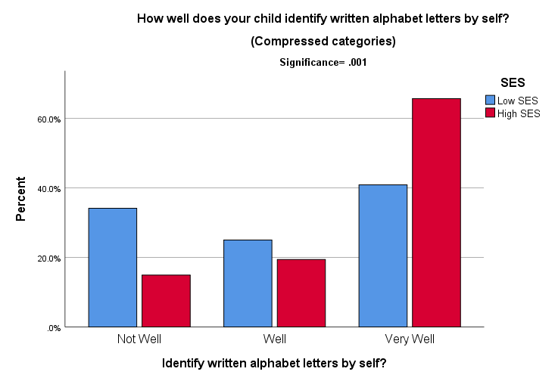
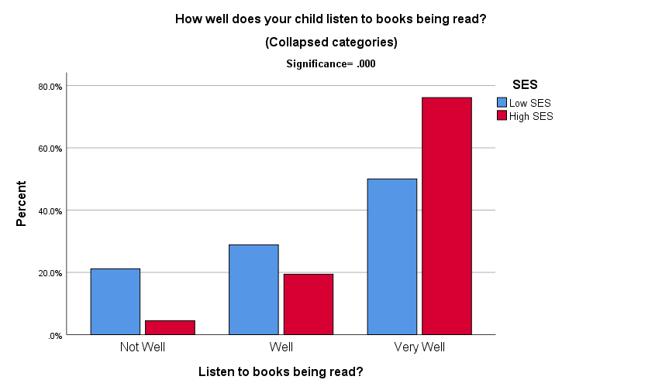

Different, Not Deficient:
Misrecognized Language Skills of Lower-Class Youth
Jacqueline Bange, Hobart & William Smith Colleges ‘19
LITERATURE REVIEW
Early Exposure to Books
Children are thought to benefit from early book exposure¹
  Research has shown this correlates with better school performance²
Differences based on SES
Even among homes with many books, there are differences in children’s narrative skills based on socioeconomic status (SES)¹
  Lower-class students’ narrative skills are different than higher-class peers but are misrecognized as deficient²
  Different, Not Deficient
Children of lower SES outperform higher SES peers in complex storytelling² and context-specific language skills³
  However, higher academic achievement by higher SES children because their skills translate well into mainstream schools¹
MEASURE OF SOCIOCEONOMIC STATUS
Considered Lower SES if:
1. Parents’ highest education level < associate’s degree
2. Child has government-sponsored health insurance
3. Child has been insured less than 12 mo. over past year
4. Child does not have both a doctor and dentist
5. Child has experienced homelessness
RESULTS
How Well Child Identifies Written Alphabet Letters by SES
How Well Child Listens to Books Being Read by SES
MEASURE OF NARRATIVE SKILLS: EXAMPLE QUESTIONS
Reading: 4 Questions
. How well does your child read his/her written name?
Writing: 3 Questions
How well does your child write his/her name by self?
Speaking: 7 Questions
Do you have difficulty understanding your child?
Listening: 2 Questions
Does your child understand what others say?
Speaking and Listening: 2 Questions
How well does your child repeat sentences when asked?
Fig. 1. Higher SES more likely to perform “very well”, Lower SES more likely to perform “not well”
RESEARCH QUESTION
What effect does SES have on children’s narrative skills?
Fig. 2. Higher SES more likely to perform “very well”, Lower SES more likely to perform “not well”
DISCUSSION
PACE Survey Limitations
PACE survey meant to measure mainstream learning skills before kindergarten
  May not be suited to measure non-normative narrative skills of lower SES children
  Questions about speaking and listening measure normative forms
  Number of questions to measure each narrative skills varies
Influence of Parents’ Perceptions
Survey answers reflect parents’ perceptions of children’s skills, not reality
  Lower SES parents may score their children poorly due to societal view of them as deficient
Future Research
Additional research is crucial to help close achievement gap and make classrooms better-suited to foster unique narrative skills of all students
METHODS
Sample
Obtained from existing Parental Appraisal of Children’s Experiences (PACE) data through University of Rochester
  Surveys completed by parents of children entering kindergarten in Geneva, NY in 2017 and 2018
    N = 276 (Response rate: 81.18%)
Examine Effect of SES on Children’s Narrative Skills:
1. Reading 2. Writing 3. Speaking 4. Listening 5. Speaking and Listening
Hypotheses
Higher SES children will have higher reported measures of reading and writing skills than their lower SES peers.
Lower SES children will have higher reported measures of speaking and listening skills than their higher SES peers
25
women
RESULTS
1.) Higher SES & High Reading and Writing Supported
Significant findings for higher SES associated with all four measures of reading well, and two out of three measures of writing well
2.) Lower SES & High Speaking and Listening Not
Supported
Higher SES also associated with higher speaking and listening skills
  Significant findings for higher SES associated with two out of seven measures of speaking well, one out of two measures of listening well, and one out of two measures of speaking and listening well
32
seniors
18
1st-years
WORKS CITED
Heath, Shirley Brice, “What No Bedtime Story Means: Narrative Skill at Home and at School”. 1982.
Miller, Peggy J. and Sperry, Douglas E., “Déjà vu: The Continuing Misrecognition of Low-Income Children’s Verbal Abilities”. 2012.
Clancy, Patricia M., “The Acquisition of Communicative Style in Japanese”. 1986.

