Slide 1
St. Peter’s Episcopal Church
Community Based Research & Service Learning

Slide 2
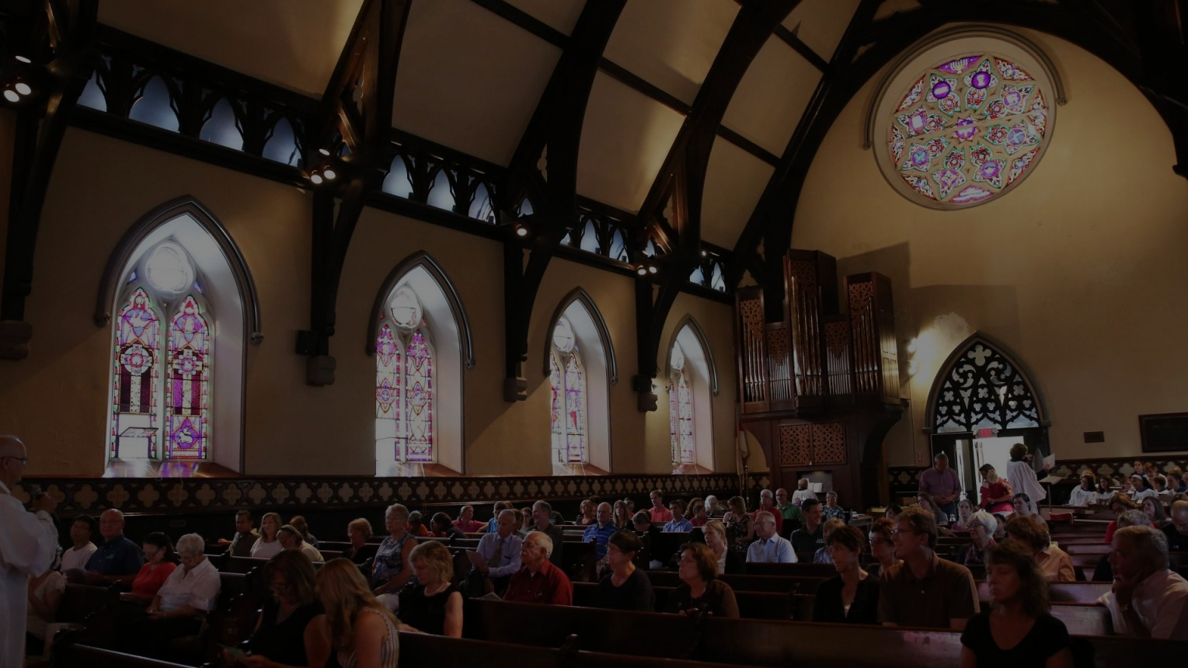
Mission statement:
St. “Peter’s is deeply committed to its neighborhood, the city of Geneva, and our Finger Lakes Region. At St. Peter’s we believe that the Church belongs to the people and its neighborhood. St Peter’s parish hosts several important missions and ministries that welcome and serve our community. We encourage individuals to join us and volunteer. St Peter’s also welcomes new missions the might serve our community.”
https://stpetersgeneva.org

Slide 3
The History of St. Peter’s
Re-integration of the church into Geneva and the surrounding community
Father Adams is inducted as St. Peter’s new rector. Restoration of the church building and facilities begins.
Cooking Matters program is launched
1981 |  | 1987 |  |  |  |  | 2005 |  | 2016
Neighbors’ Night program is put in motion
St. Peter’s Community Arts Academy is founded

Slide 4
Three Programs of Focus
Cooking Matters
Neighbors’ Night
St. Peter’s Community Arts Academy (SPCAA)
Under the direction of the faculty and staff at Hobart & William Smith Colleges as well as the various community coordinators I came to serve as the partnering intern for the Neighbors’ Night Program, the Cooking Matters Program, and SPCAA.

Slide 5
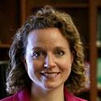
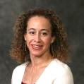
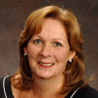
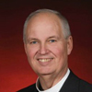
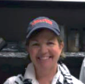
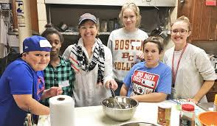
My Mentors
Katie Flowers
Donna Davenport
Sue Adams
Rev. Jim Adams
Eileen Cooley
Director of CESL, Staff Sponsor
Faculty Sponsor & Advisor, Professor of Dance & Social Justice Studies, Dean of Faculty at SPCAA
Community Partner, Parish Administrator, Neighbors’ Night Director, Academy Administrator at SPCAA
Community Partner, Rector at St. Peter’s, Head of School at SPCAA
Community Partner, Cooking Matters Program Director
https://stpetersgeneva.org
https://www.fltimes.com/lifestyle/cooking-matters/image_b2b727ad-f58c-508a-94b7-d9cda0485ed1.html

Slide 6
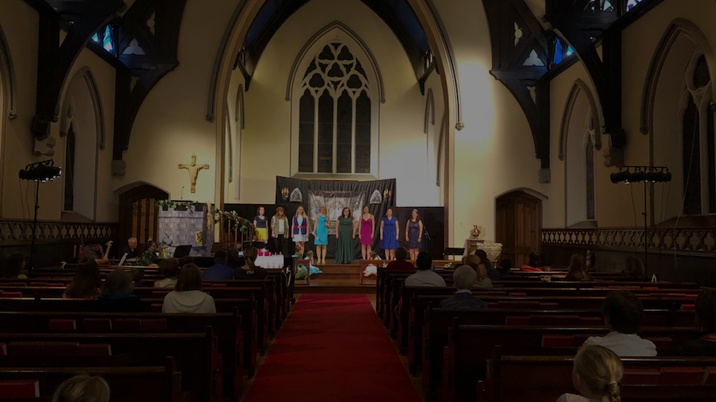
Why these programs?

Slide 7
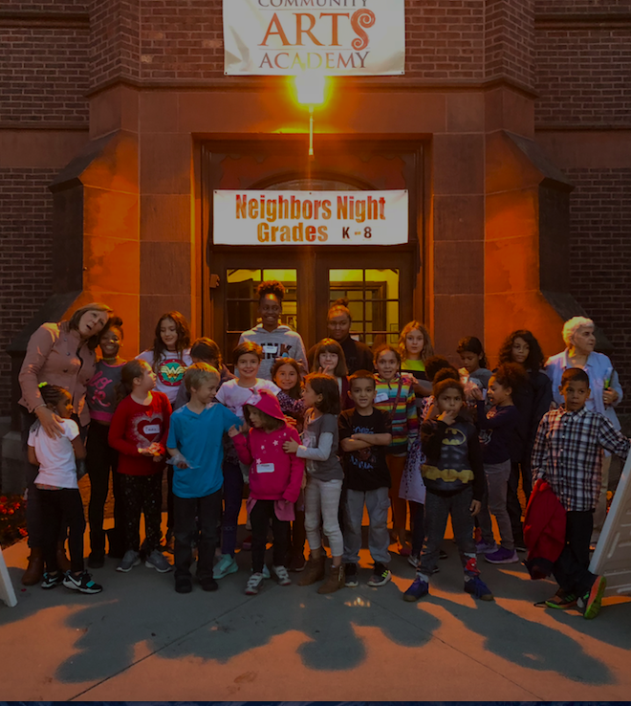
Neighbors’ Night
Launched a response to the wake of vandalism which followed the restoration of the church in 1986. Also created to benefit the children living in the Geneva Community through a night of storytelling, songs, crafts, games and dinner. Initiated to establish a relationship of trust and respect between the surrounding neighborhood and the church.

Slide 8
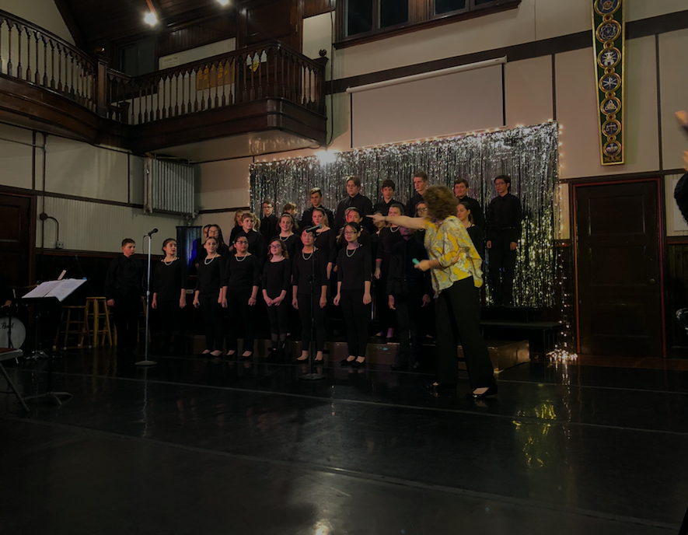
St. Peter’s Community Arts Academy
Initiated with the mission of providing “Arts for All” people regardless of their religion, ethnicity, or socio-economic background. Also brings the community greater access to music and dance by providing lessons and instruction not available at surrounding schools.

Slide 9
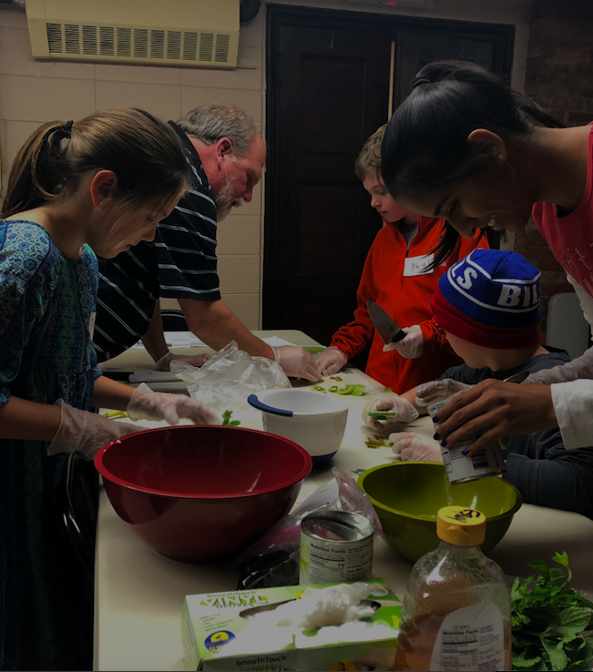
Cooking Matters
A collaborative effort to engage children in grades 5th through 8th, that have been deemed to be a part of a “high-risk” population. The program provides lessons in nutrition, healthy food choices, meal preparation, grocery shopping, and kitchen skills.

Slide 10
My Role in These Programs
Typical tasks and responsibilities
SPCAA
Event programing
Event organization
Event set-up and break down
Community outreach
Event promotion and advertisement
Program packet design and editing
Website design and editing
Inter-departmental coordinating
Office and “housekeeping” tasks
Sound and audio technician
Neighbors’ Night
Cooking Matters
Student Program Coordinator in partnership with HWS CSEL
Volunteer Recruitment
Volunteer transportation
Programing
Program Set-Up and Breakdown
Student Program Coordinator in partnership with HWS CSEL
Volunteer Recruitment
Volunteer transportation
Programing
Program Set-Up and Breakdown
Fundraising

Slide 11
Reflection
Takeaways from a successful and progressive non-profit
1
Values
Ideals to lead and guide by
Community engagement, equity, collaboration, diversity, integrity, etc.
2
Mission
Determine the organization’s core purpose and focus
To create a rich cultural environment accessible to all regardless of socio-economic standing
3
Vision
Identify what the organization hopes to become
Progressing, transforming, and expanding philanthropy aimed to uplift the community
4
Plan
Establish a timeline and goals
Deadlines, business plans,, long term to short term goals
5
Create Your Team
Find those with skills that are both needed and desired
Instructors, financial advisors, design firms, campaign advisors, endowment
6
Stakeholders
Identify those with means to support the organization and get them on board
Grants, philanthropy organizations, community donations, benefit events
7
Act
Take decisive action
Initiation of the Neighbors’ Night, Cooking Matters, Community Arts Academy, and coordinated events

Slide 12
Leading a Non-Profit Organization
Qualities of a non-profit leader
Transformational and Transactional Leadership Qualities
Responsive and proactive
Works with in but also to progress the organization's structure
Power, Influence, and Authority
Successful Leader

Slide 13
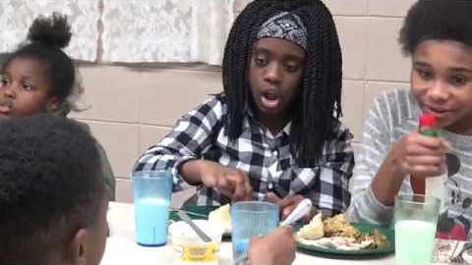
Source: https://www.youtube.com/watch?v=0MxK5x3CyL0

Slide 14
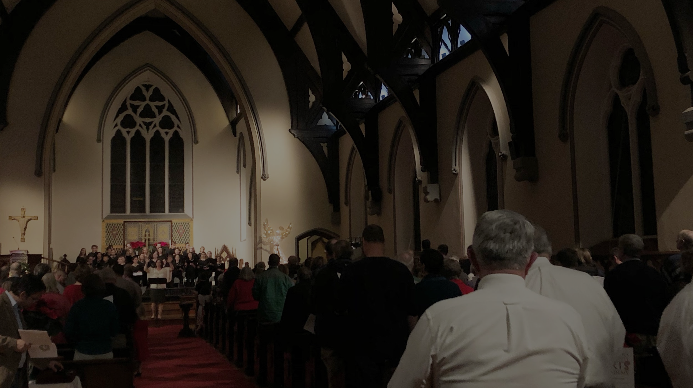
What’s next for St. Peter’s?
St. Peter’s Episcopal Church and St. Peter’s Community Arts Academy Capital Campaign

