Slide 1

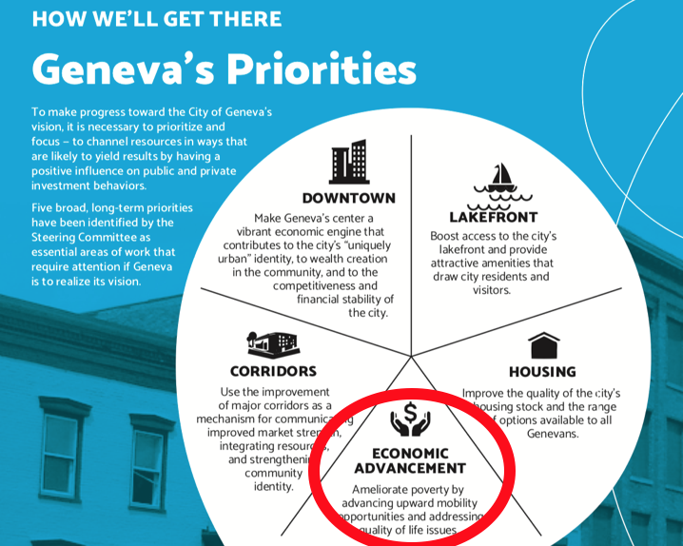
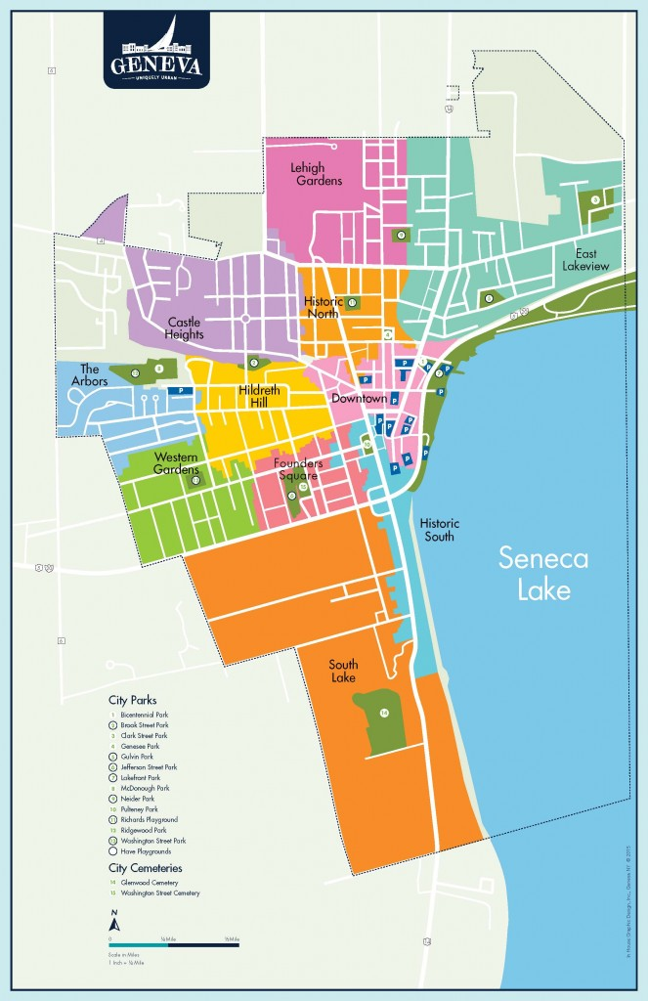
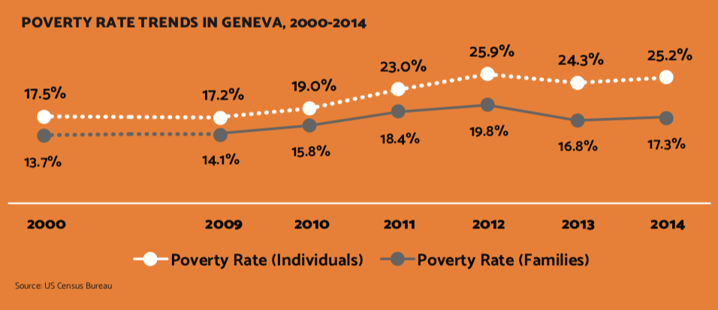
I Got 99 Problems and Poverty Is All of Them:
The City of Geneva Anti-Poverty Initiative
Cameron Adams, Jody Henkels, Sarah Garrett, Allison Magnarelli, and Morgan Stevens
Senior Sociology Seminar - Hobart and William Smith Colleges
Project Proposal
Research
Survey Results
A comprehensive consultation for a new strategy in the City of Geneva to address quality of life issues that contribute to the likelihood of poverty. By researching trauma informed care and the collective impact model, we have presented our research to Sage Gerling, Interim City Manager, providing our recommendation of what model will work best for the City. We have conducted a survey targeting over 30 service providers in the area to see how they can contribute to the models researched.
Two Models:
Collective Impact: An innovative, structured approach that brings together a wide variety of stakeholders who use data to identify root causes of a problem. Once the complexity of a problem is understood, solutions can be implemented and the outcomes can be monitored by using shared measures.
Trauma Informed Care: A method of treatment that involves understanding, recognizing, and responding to the effects of all types of trauma (ex. violence, abuse, neglect, disaster, etc.).
Anti-Poverty Initiatives in Other Communities:
Northeast Region
Family Independence Initiative: community building platform with Analytics4 and UpTogether. “The first group of Boston families, who joined in 2010, saw median income jump 16 percent in two years. Half of those who started out below the poverty line crossed it.” WBUR News
West Coast/Midwest Region
Midwest City, OK Action Plan: follows a citizen participation plan that encourages citizen involvement in the planning process that develops and provides activities that reflect the needs of citizens. This is done with a Citizens’ Advisory Committee on Housing and Community Development.
Southern Region
Georgia Budget and Policy Institute Series. Implemented a Temporary Assistance for Needy Families (TANF) and MOE-funded programs that move a number of Georgia families from poverty to self-sufficiency.
European Region
COPE Germany, 2020 Europe, and The European Mental Health Action Plan 2013-2020. The later, concludes that education at an early age about mental health and service providers available is the best policy to combat the rising number of vulnerable and at-risk individuals.
Finger Lakes Region
Consortium on Trauma, Illness, and Grief in Schools (TIG). Trauma Informed Care: Organizational Self-Assessment Tool (TIC-OSAT).
Example Survey Questions:
Who is your typical client (families, children, individuals)?
What are the challenges your agency faces? (Socially, economically, internally, etc.)
Do you have a client wait list?
If you had unlimited resources, money, and staff, what would you want to solve first?
Key survey findings:
Responses from 17 out of 34 service providers in and around Geneva, NY
75% of participants listed funding as a main challenge that their organization faces
Major themes from responses include the need for collective impact, focusing on life circumstances of the family as a whole, lack of funding, staff retention and training, trauma informed care, transportation, affordable housing, and the skills gap
Main Objectives
To assess other poverty amelioration strategies and see if they would be feasible for implementation in the City of Geneva. Our research sought to answer the following questions:
1. What strategies are being used in other communities?
a. Collective Impact Model
b. Trauma Informed Care
2. What makes these programs successful in their communities?
3. Would these programs be successful in the City of Geneva?
4. How can various service providers, such as Social Services, Catholic Charities, the Salvation Army, etc., be part of the strategy?
Recommendation
Economic Opportunity Task Force – We recommend the City of Geneva implement a group of engaged citizens who are tasked with brainstorming ideas and programs to benefit upward mobility and support to families living in poverty.
Step one: Launch a pilot program using the same framework as the Family Independence Initiative, which strives to change the narrative around low-income families and empowers them to be the leader in their own path to success
Step two: Develop sources of funding and search for the physical location where such a program will operate
This model is based on both the collective impact and trauma informed care models. The program is designed to provide a web of service providers and aid from one overarching and interconnected platform. A strong community network should be emphasized, as well as empowering families to create their own identity.
Bibliography
Comprehensive Plan
“How Can We Help?” The Consortium on Trauma, Illness and Grief in Schools, Coordinated Care Services, Inc., 14 Jan. 2018, tigconsortium.org/.
“Trauma Informed Care: Organizational Self-Assessment Tool.” Coordinated Care Services, Inc., www.ccsi.org/Pages/TIC-OSAT.
Midwest City, OK. “Executive Summary 2017 Action Plan: Year Three of the Five Year Consolidated Plan and Strategy 2015-2019.” 2017, no:2506-0117
“Home.” FII – Family Independence Initiative, www.fii.org/.
In 2014, Geneva had 12% of Ontario County’s population but was home to 25% of county residents living in poverty – more than twice the city’s proportionate share.

