Slide 1
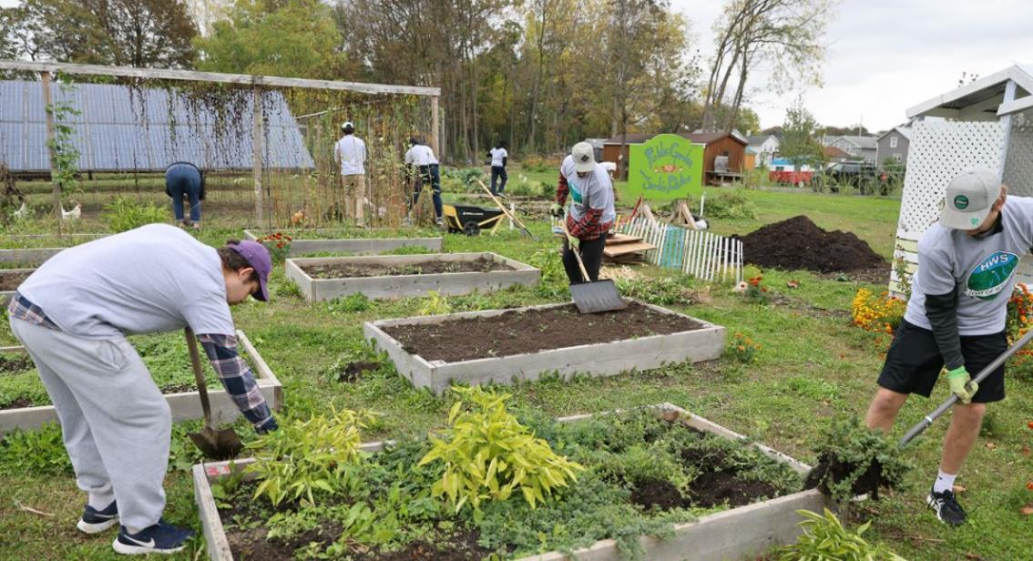
THE CENTER FOR COMMUNITY ENGAGEMENT & SERVICE LEARNING (CCESL)
Hobart and William Smith Colleges

Slide 2
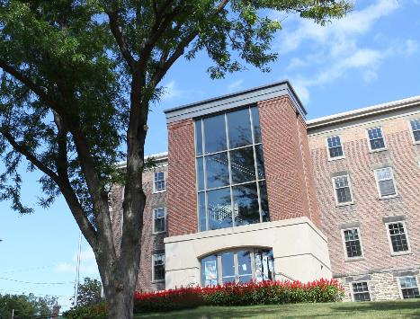
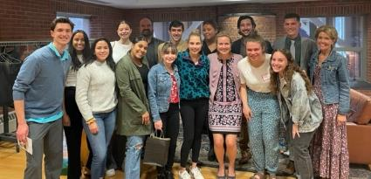
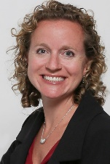
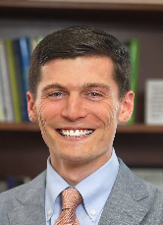
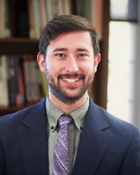
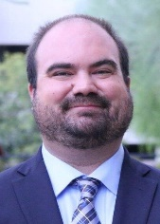
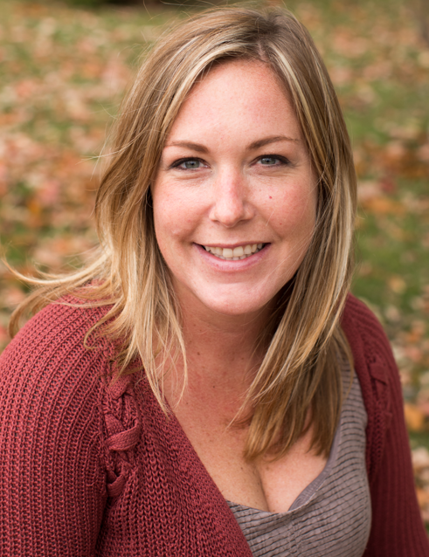
MEET THE TEAM
Katie Flowers (she/her)- Director
Peter Budmen, H’15 (he/him) – Assistant Director
Alex Cottrell, HWS ’20 (he/him) – Graduate Assistant
Craig Talmage (he/him)– CCESL Faculty Adviser and Liaison
Heather Mills (she/her)- Geneva 2030 Director
Civic leader cohort, campus chapter/clubs (Habitat for Humanity, Girl Scouts, Big Brothers Big Sisters), Service-learning classes, CCESL Link House, Civic Engagement Scholars, Summer of Service internship program, Program impact and evaluation
HWS Corps Youth Tutoring, Co-curricular service programming, including political engagement (HWS Votes), Days of Service, HWS GEMS, Red Cross Blood Drive, Holiday Gift Project, HWS Donation effort
HWS Corps Youth Tutoring @ The Boys and Girls Club, Student Assistants
Supporting Community Engaged Teaching, Learning, and Research
Since 2011, Geneva 2030, a collective impact initiative, has worked together with youth + equity focused partnerships in the Geneva community to support Geneva’s children from the “cradle to career.”
Senior Civic Leader
CCESL CIVIC LEADERS
Student Leaders working on CCESL initiatives and projects

Slide 3
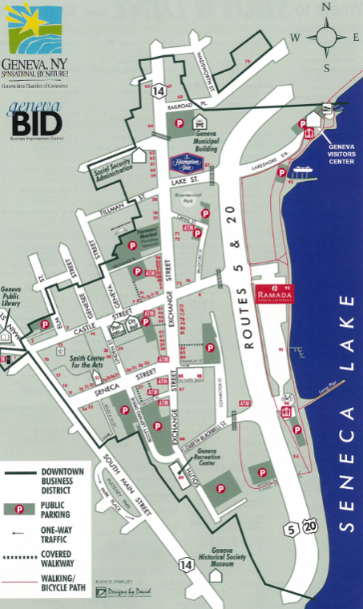
WHERE TO FIND US
660 South Main Street, Trinity Hall 203 (second floor)
serve@hws.edu
(315) 781-3825
www.hws.edu/centers/service/
HWS CCESL
@HWSCCESL
@HWS_CCESL

Slide 4
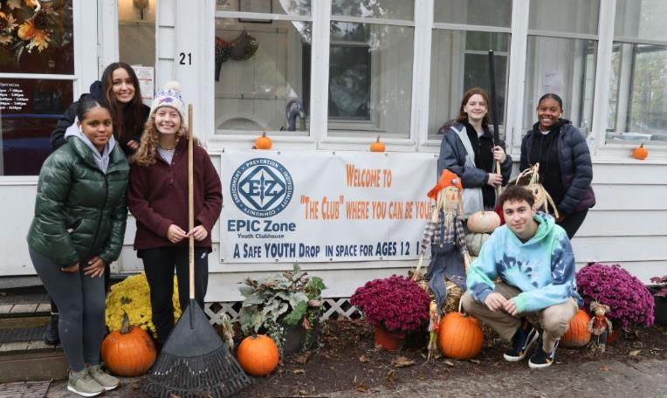
ABOUT US
INDUSTRIAL BUILDINGS
MISSION
VISION
We stand for learning through service that guides students who are civically engaged and graduates who the have skills to be active global citizens.
Jupiter is a gas giant and the biggest planet in our Solar System. It’s the fourth-brightest object in the sky
A sustained, engaged relationship with the community that promotes positive community change and enhanced student learning.

Slide 5
Charting your direction towards a life of consequence
Engaged
Citizenship
Civic
Leadership
Civic Engagement
Engage with our monthly newsletter,
The Compass Times…delivered to your inboxes!
Community Service

Slide 6
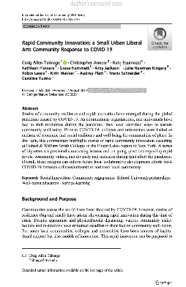
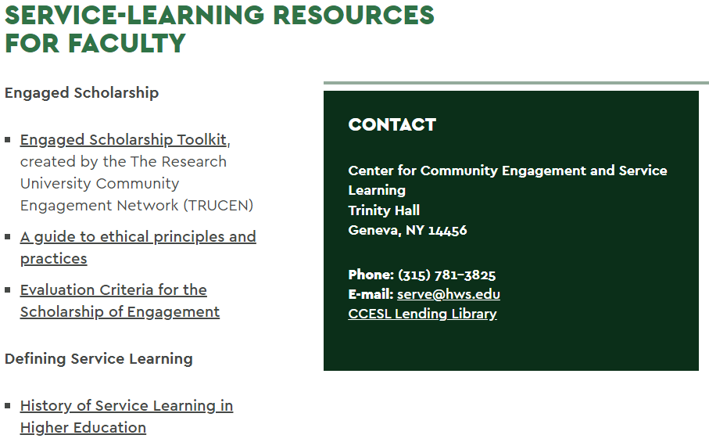
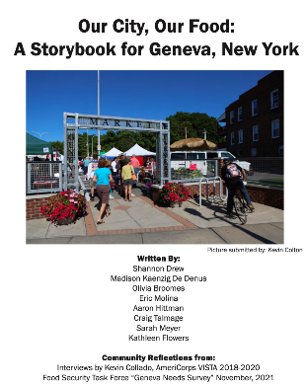
Community Engaged Learning, Teaching, and Research
CCESL is committed to supporting community engaged learning, teaching, and research at HWS and in the FLX community. CCESL helps get that work published in many different venues!
Example Publications
EMPLOYEES
Get Started
Fill out our CCESL Survey: https://www.surveymonkey.com/r/FFNJSFB
Reach out to CCESL for coaching
Check out our community partners proposals on the CCESL website

Slide 7
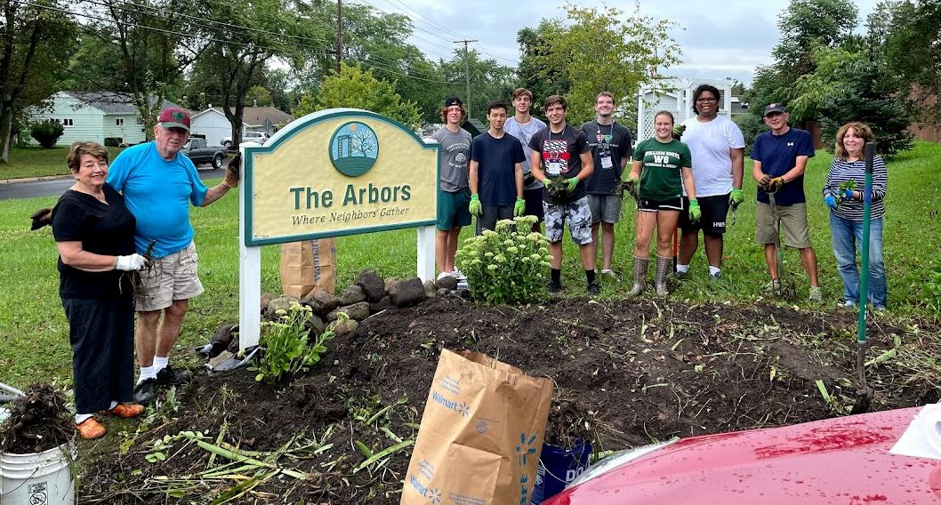
OUR PROGRAMS AT A GLANCE
ALL YEAR
FALL SEMESTER
SPRING SEMESTER
SUMMER
Service-Learning Classes
Community Based Research projects
Service clubs
HWS Corps (Youth Tutoring)
HWS Civic Scholars
FLX College Leader Corps
HWS Votes
CCESL Link House
AmeriCorps + Peace Corps recruitment
First Year Orientation Day of Service
Fall Day of Service
Community Lunch Program
Red Cross Blood Drive
Holiday Gift Project
Community Lunch Program
Red Cross Blood Drive
GEMS
Spring Day of Service
Alternative Spring Break Trips
Community Engaged Scholarship Forum
HWS Community Donation
Summer of Service
CCESL is proud to have supported the ‘cradle to career’ and equity focused work of Geneva 2030 since 2011!

Slide 8
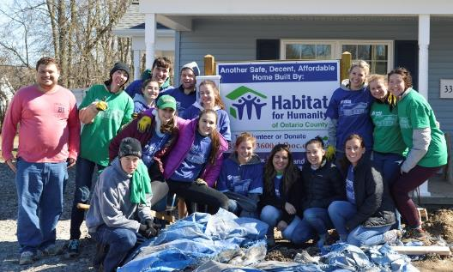
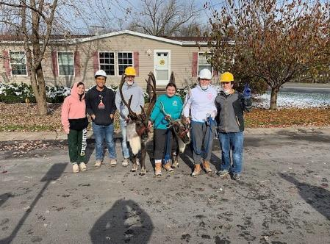
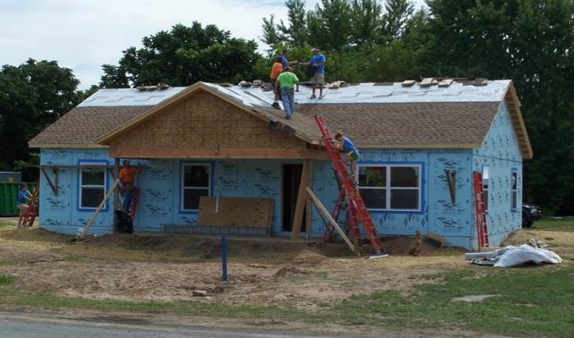
Habitat for Humanity
The HWS chapter works with local organizations to aid in the construction of safe housing for area residents. Email habitat@hws.edu and follow on IG (hws4habitat) for more information!

Slide 9
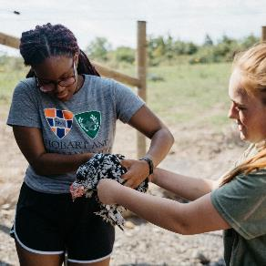
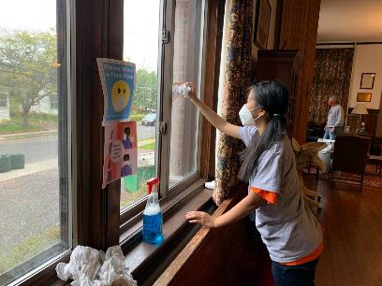
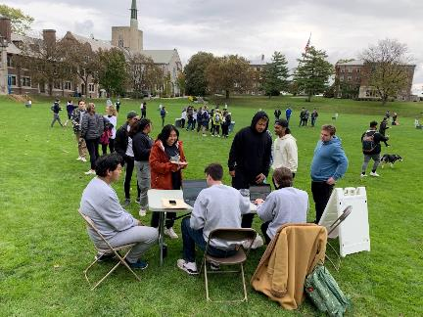
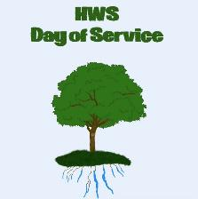
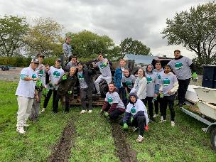
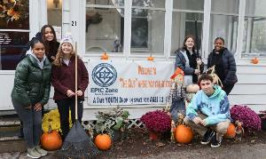
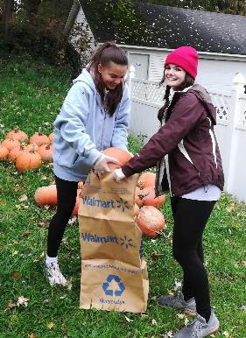
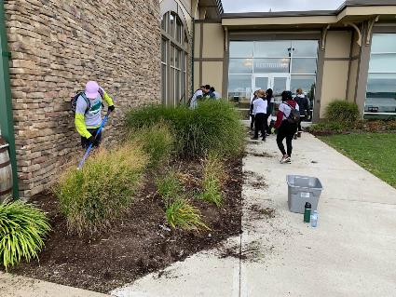
Days of Service
Students, faculty, staff and community members come together to perform acts of service in and around the Geneva community during these annual service events. (Fall and Spring) email dos@hws.edu or follow on IG hwsdaysofservice

Slide 10
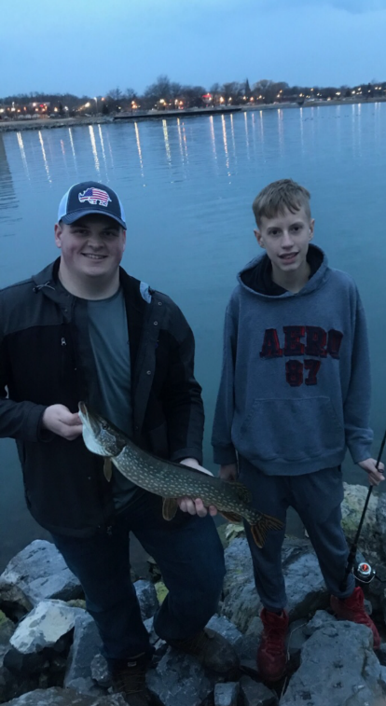
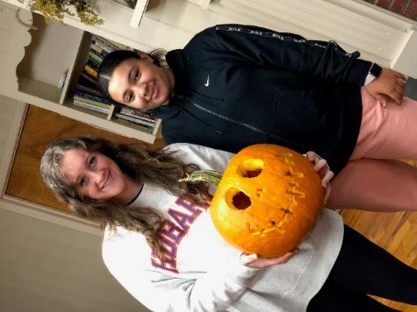
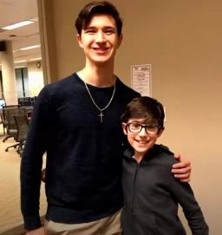
Big Brothers Big Sisters
Helps local youth ages 6-16 meet their potential by matching HWS students in one-on-one mentoring relationships. Weekly one-on-one interactions, year commitment – become a “big”!

Slide 11
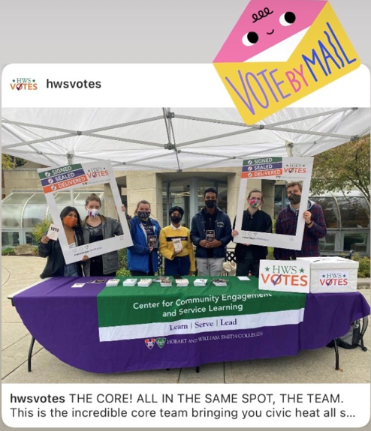
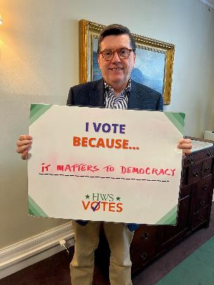
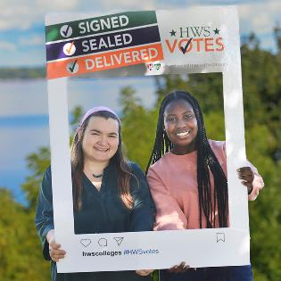
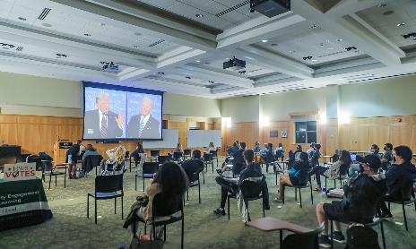
HWS Votes
Voter Registration + Absentee Ballot info
Voter Education
Election Day transportation
Non-partisan programming, movie nights, panel discussions, Congress to Campus, etc.
Email vote@hws.edu or follow on IG @hwsvotes

Slide 12
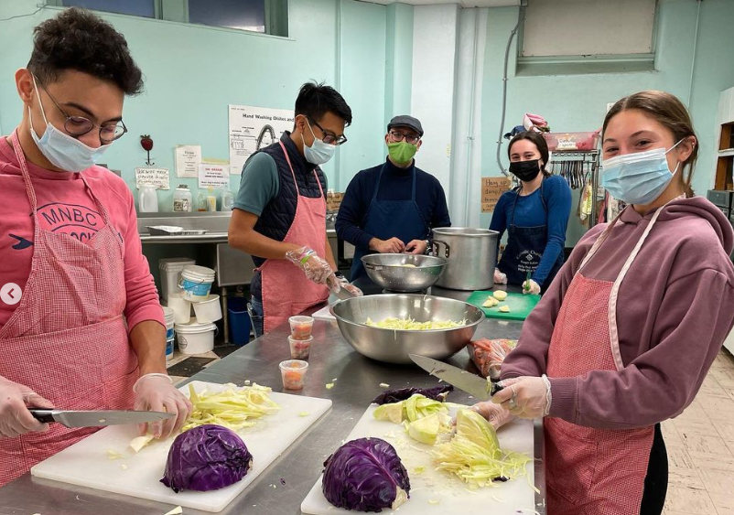
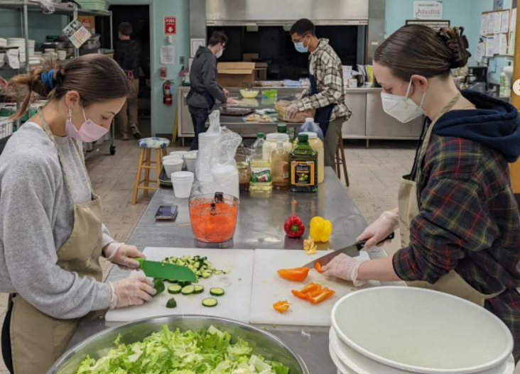
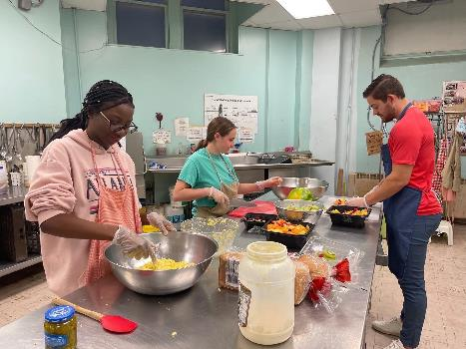
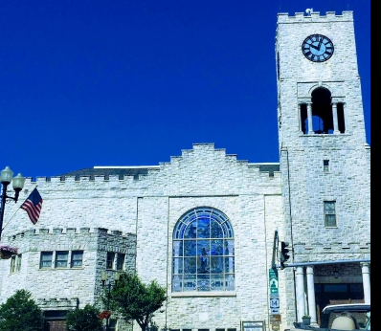
Community Lunch Program
Students, faculty and staff work together to prepare and serve a hot meal for community members for 8 Thursdays during the school year (October and February).

Slide 13
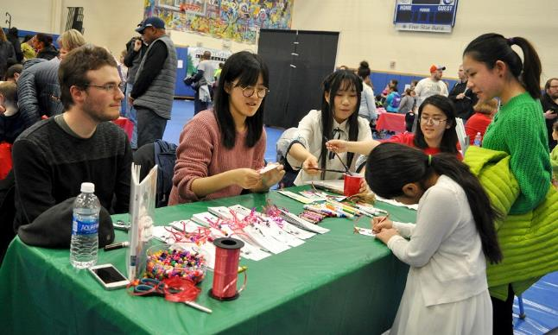
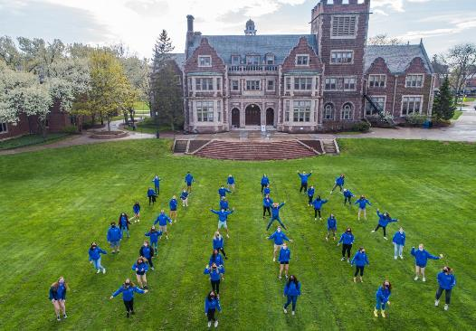
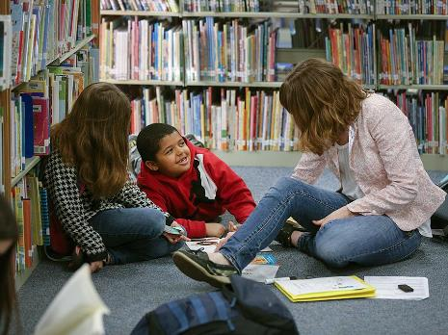
HWS Corps @America Reads
Established in 1989, A federal work study program (earn $) which places HWS tutors in six area schools. Tutors spend one-on-one time with an elementary aged student to help improve upon their reading and writing skills and abilities.

Slide 14
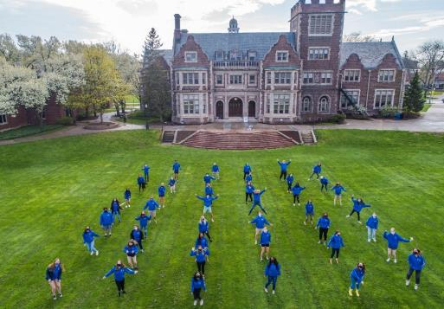
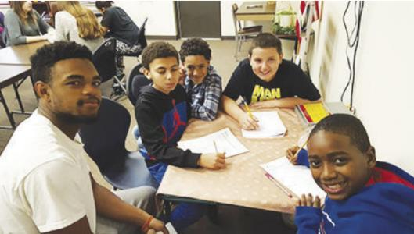
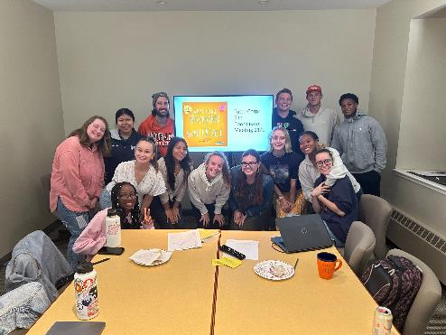
HWS Corps @Boys and Girls Club
Two locations (Geneva Community Center and Goodman St.) tutors head to the Boys and Girls Club to tutor and mentor local Geneva students. Power Hour allows students to asks their tutors questions and after they all get to go play in different program areas (art room, gym, games room, and/or the computer lab)

Slide 15
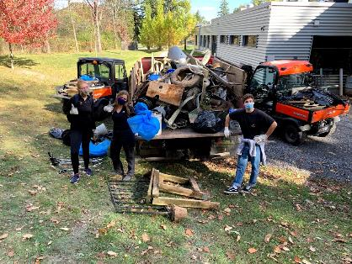
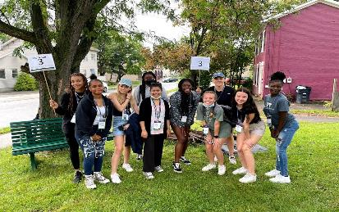
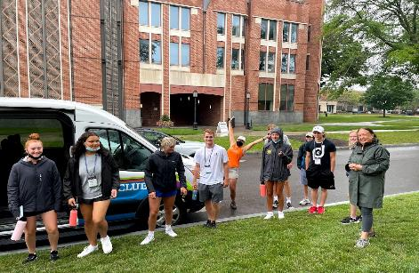
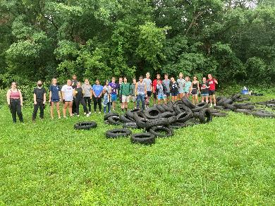
First Year Orientation Day of Service
STAGE 1
STAGE 2
STAGE 3
Reach out to Community Partners and work on setting up project sites!
Sort Orientation groups into the different project sites and arrange transportation!
STAGE 3
Send the First Year class and Orientation team out into the community!
Plan for the next annual Days of Service!
STAGE 4

Slide 16
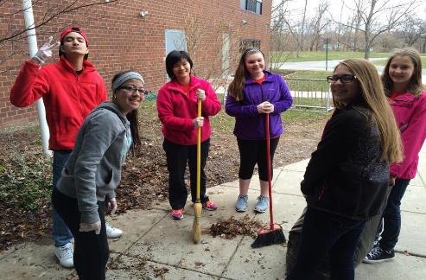
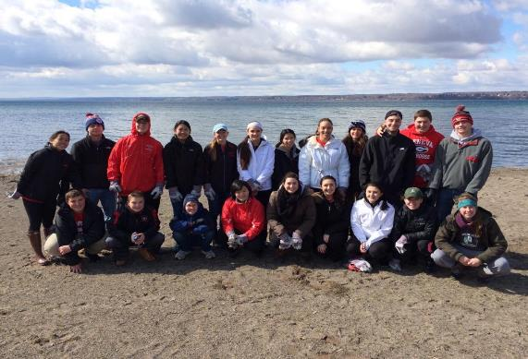
Geneva Engagement Mentoring and Service (GEMS)
Geneva Heroes
GEMS
Established in 2002, Geneva Heroes was a program organized by HWS students which pairs HWS with GHS with GMS students to do service projects in the community!
Reimagined, Geneva Heroes, now GEMS, focuses on mentoring students through the college process. College mentors meet weekly with local high school & middle school students with activities focused on learning more about college.

Slide 17
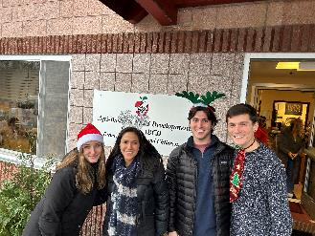
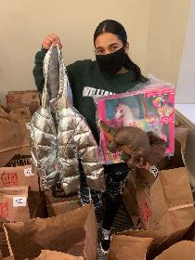
Holiday Gift Project
STAGE 2
STAGE 4
Make a call to HWS & Geneva Community for individuals to donate gifts or make financial contributions.
Organize and sort donations in the basement of Trinity
STAGE 1
STAGE 3
STAGE 5
Work with Geneva Head Start and Geneva ABCD to identify students in need of gifts.
Collect donations of gifts or money, buy gifts with monetary donations.
Deliver gifts to Head Start or ABCD to be distributed!

Slide 18
Alternative Spring Break Trips
Throughout the pandemic, students were encouraged to explore virtual volunteering opportunities
HWS students have gone to New Orleans, Virginia, North Carolina, Nicaragua, Jamaica, Tennessee, Pennsylvania, The Bronx, New Jersey and the Gulf Coast

Slide 19
HWS COMMUNITY DONATION EFFORT
Barn Sale
HWS COMMUNITY SALE
HWS DONATION EFFORT
Established in 2006, the Barn Sale started as a fundraiser to sell those unwanted but still useable items college kids would leave or otherwise throw away! Barn sale proceeds benefited United Way until 2014.
In total since 2006, the Community Sale has raised over $100,000 for various organizations and diverted over 120,000 lbs. of waste from the landfill.
As a result of COVID-19, the Community Sale has transformed yet again into a direct Donation effort!
By 2017, The Barn Sale has evolved into the HWS Community Sale and moved down to Geneva Recreation Center with proceeds benefiting Geneva 2030.

Slide 20
MERCURY
Model
SATURN
Mission
Vision
Geneva 2030 engages a broad array of community voices by building awareness and information sharing; involving and mobilizing the community toward improving educational outcomes and economic mobility for youth; and co-developing solutions and strategies with community members.
Geneva 2030 connects and empowers all members of the community to advance equity and support the success of every Geneva child, cradle to career, by creating and transforming the systems that shape opportunity.
StriveTogether helps communities like Geneva move toward true collaboration with youth and families, coaching leadership teams to strengthen engagement and sharing insights across the Cradle to Career Network.
Geneva 2030 gratefully acknowledges Dr. Philip Breitfeld, Strive Together Network, ESL Charitable Foundation, Max and Marian Farash Charitable Foundation, Rochester Area Community Foundation and the Wyckoff Family Foundation for ongoing financial support

Slide 21
Structure
Executive Board
Advisory Board
Action Teams
STEAM
College/Career Readiness
Birth to Kindergarten School Readiness (B2k)
Bilingual Education Success
Food Security
Parent/Community Communication
Data
Strategic Staff
Dr. Karen Fahy, Director
Laurie Bennett, Data Manager
Email geneva2030@hws.edu or follow us on Facebook or Instagram to learn more or join us!

Slide 22
Annual Community Engaged Scholarship Forum
Established in 2008, students, faculty, staff, and community partners come together to celebrate collaborations and research projects.
$50,000,000
Awards
75
EMPLOYEES
HWS Community Partner of the Year
HWS Civically Engaged Faculty Award
Compass Award for Outstanding Engaged Student Scholarship
2023 Recipients
Community Partner – Historic Geneva
Faculty Award – Chris Woodworth
Student Award – Karina Connolly ‘23

Slide 23
Summer of Service
Service doesn’t end when classes do! The program began in 2011, we’ve had close to 50 interns contribute over 14,000 hours of service to and with the community!
Thank you to the sponsors of this annual summer internship program!
Internships change each year depending on the needs and interest of both students and community partners! Check out past internships here!

Slide 24
Post Grad Year of Service programs… “Gap Years”
CCESL is a proud partner to many national and international service organizations. HWS is 1 of a few hundred institutions to match up to $1,000 in AmeriCorps awards if applied towards tuition.

Slide 25
Resources
Engage with our bi-monthly newsletter, The Compass Times
Find information about our various programs and clubs on HWS Engage! You’ll find application to student positions here too
Check out what Geneva has to offer with this eatery list! Or learn more about Geneva’s history with this video

Slide 26
THANK YOU!
Any questions?
serve@hws.edu
(315) 781-3825
www.hws.edu/centers/service/

