Slide 1
Finger Lakes Geology
Source: Fullerton, 1980, USGS Professional Paper 1089)

Slide 2
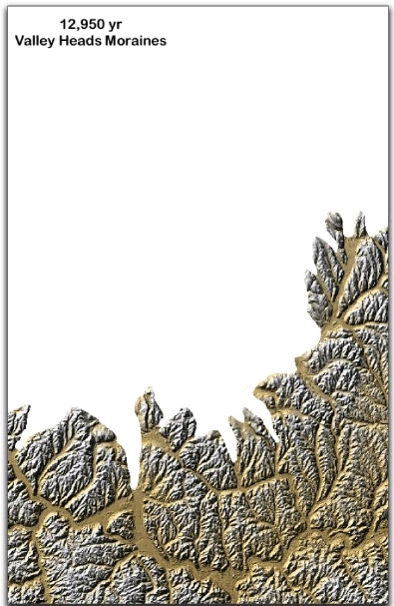
How the FL Were Formed
Notes:
This QuickTime movie shows the withdrawal of the continental ice cap from the Finger Lakes region between about 12,000 and 13,000 years ago. As the ice cap retreated from this region, progressively lower and lower elevation spillways were exposed to the north and the levels of the lakes which formed just south of the ice cap dropped, sometimes precipitously. Remarkably, this entire process took just ~1000 years. The red dot in each frame is the location of the Cornell campus.
Lakes Ithaca, Watkins, and Newberry drained southward (and possibly westward), whereas Lake Dana and Iroquois flooded out the ancestral Mohawk River, creating super potholes at Little Falls near Utica and other specatcular features. The interpretation of the timing is from Fullerton (1980, USGS Professional Paper 1089).
During the time that this took place, mastadons, and probably early Native Americans roamed the area.

Slide 3
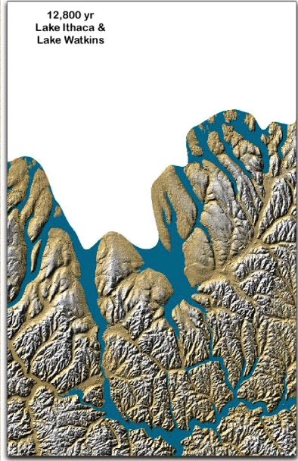

Slide 4
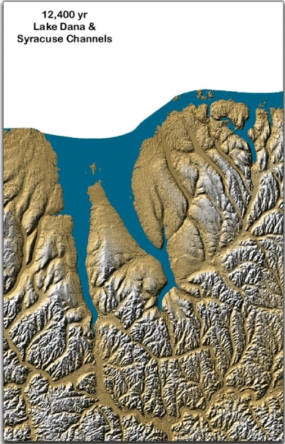

Slide 5
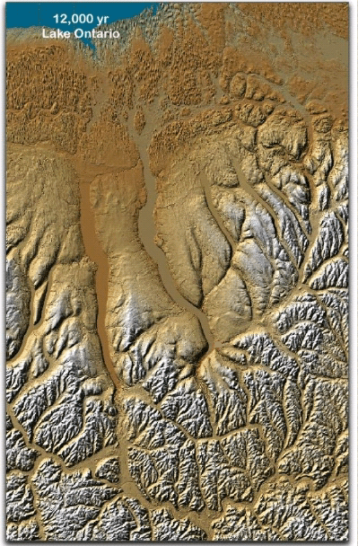

Slide 6
